Slide 1
ASIA.-LA VUELTA AL MUNDO EN 385 JARDINES
TAILANDIA.-Nong Nooch Tropical Garden.-A
Selección de textos y fotografias por
JOSE ELIAS BONELLS

Slide 2
Nong Nooch Tropical Garden
Jardines situados en Pattaya.Tailandia.
En 1954 Mr.Pisit y la Sra.Nongnooch Tansacha adquirieron una finca de 24 ha. en Rolling Hills para una plantación de frutales, mangos, naranjos cocos, y otras frutas locales.
La visita a renombrados jardines mundiales influyeron a la Sra.Nongnooch en transformar sus huertas en un jardín.
Un jardín tropical como atracción turística, con casas tailandesas, restaurantes, piscinas etc.…

Slide 3
El jardín abre en 1980 y ahora es su hijo el que lo gestiona.
El jardín recibe 2.000 visitas diarias de media al año.
Se dedica a la investigación y a la preservación de especies.
El jardín de las Cicadáceas es una de las colecciones mas documentadas del mundo.
Especializado en Bromelias, Zingiberaceas, Bouganvilleas y colecciones de Crotons. Hoyas, Cordylines, Plumerias etc.…

Slide 4
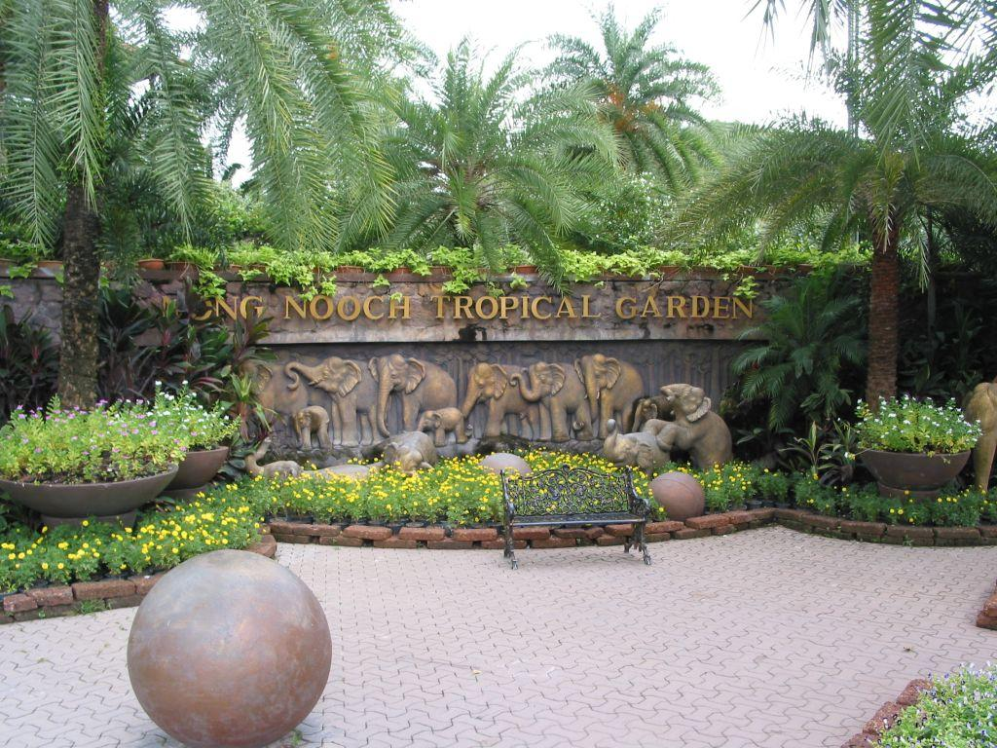
Notes:
Nong Noogh Tropical Garden-Entrada.-Thailandia

Slide 5
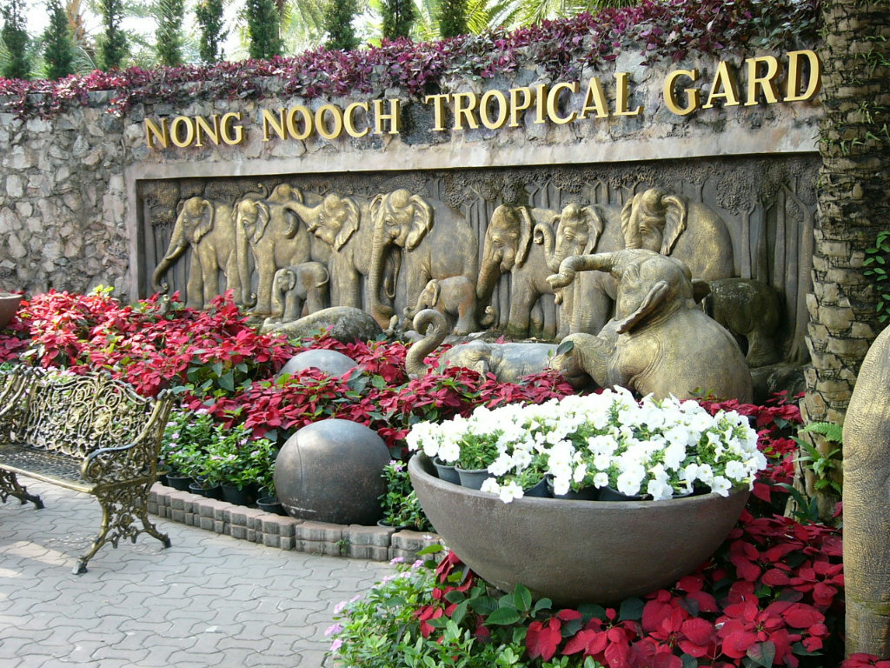
Notes:
Noon Nooch Tropical Gardens.-Pattaya

Slide 6
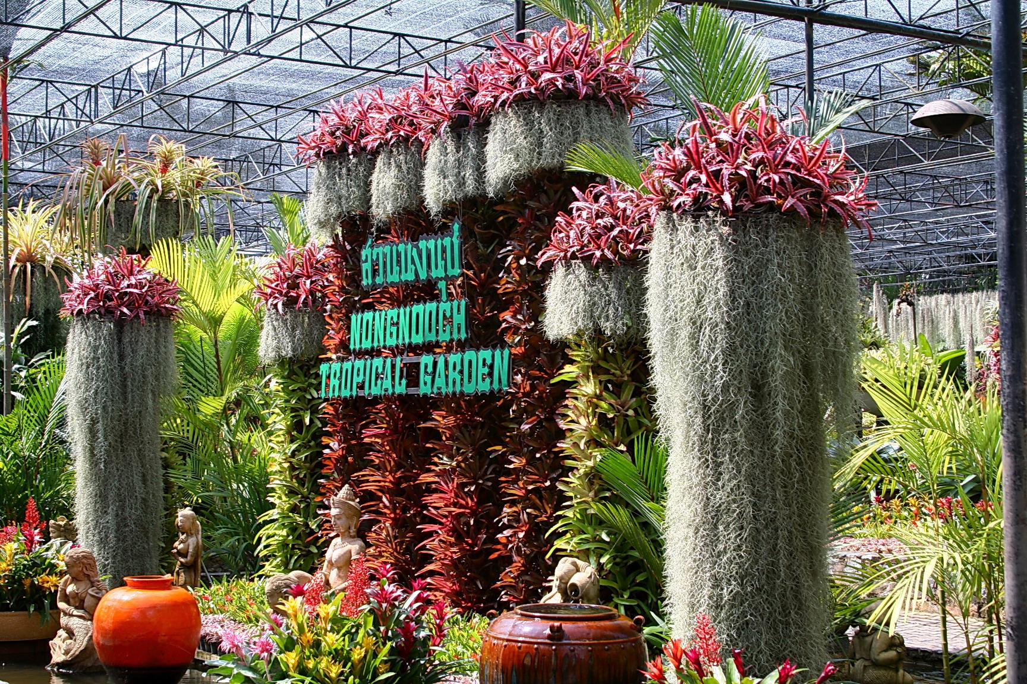
Notes:
Nong Nooch

Slide 7
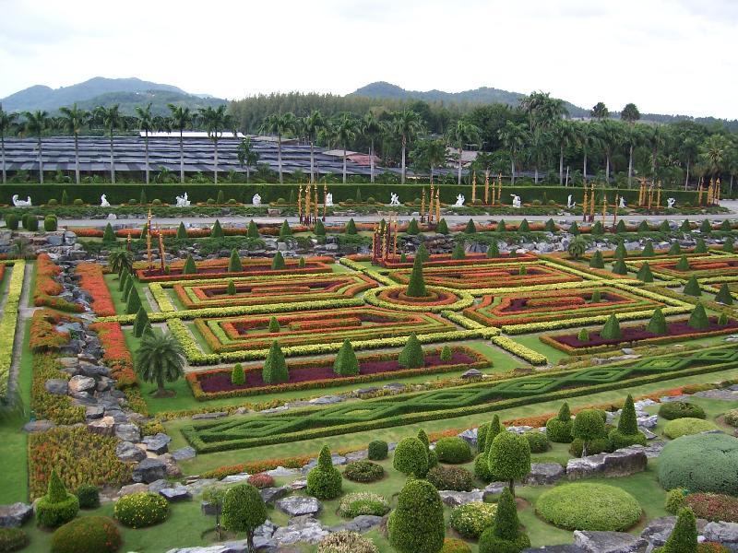
Notes:
Non Nooch Tropical Garden.-Pattaya

Slide 8
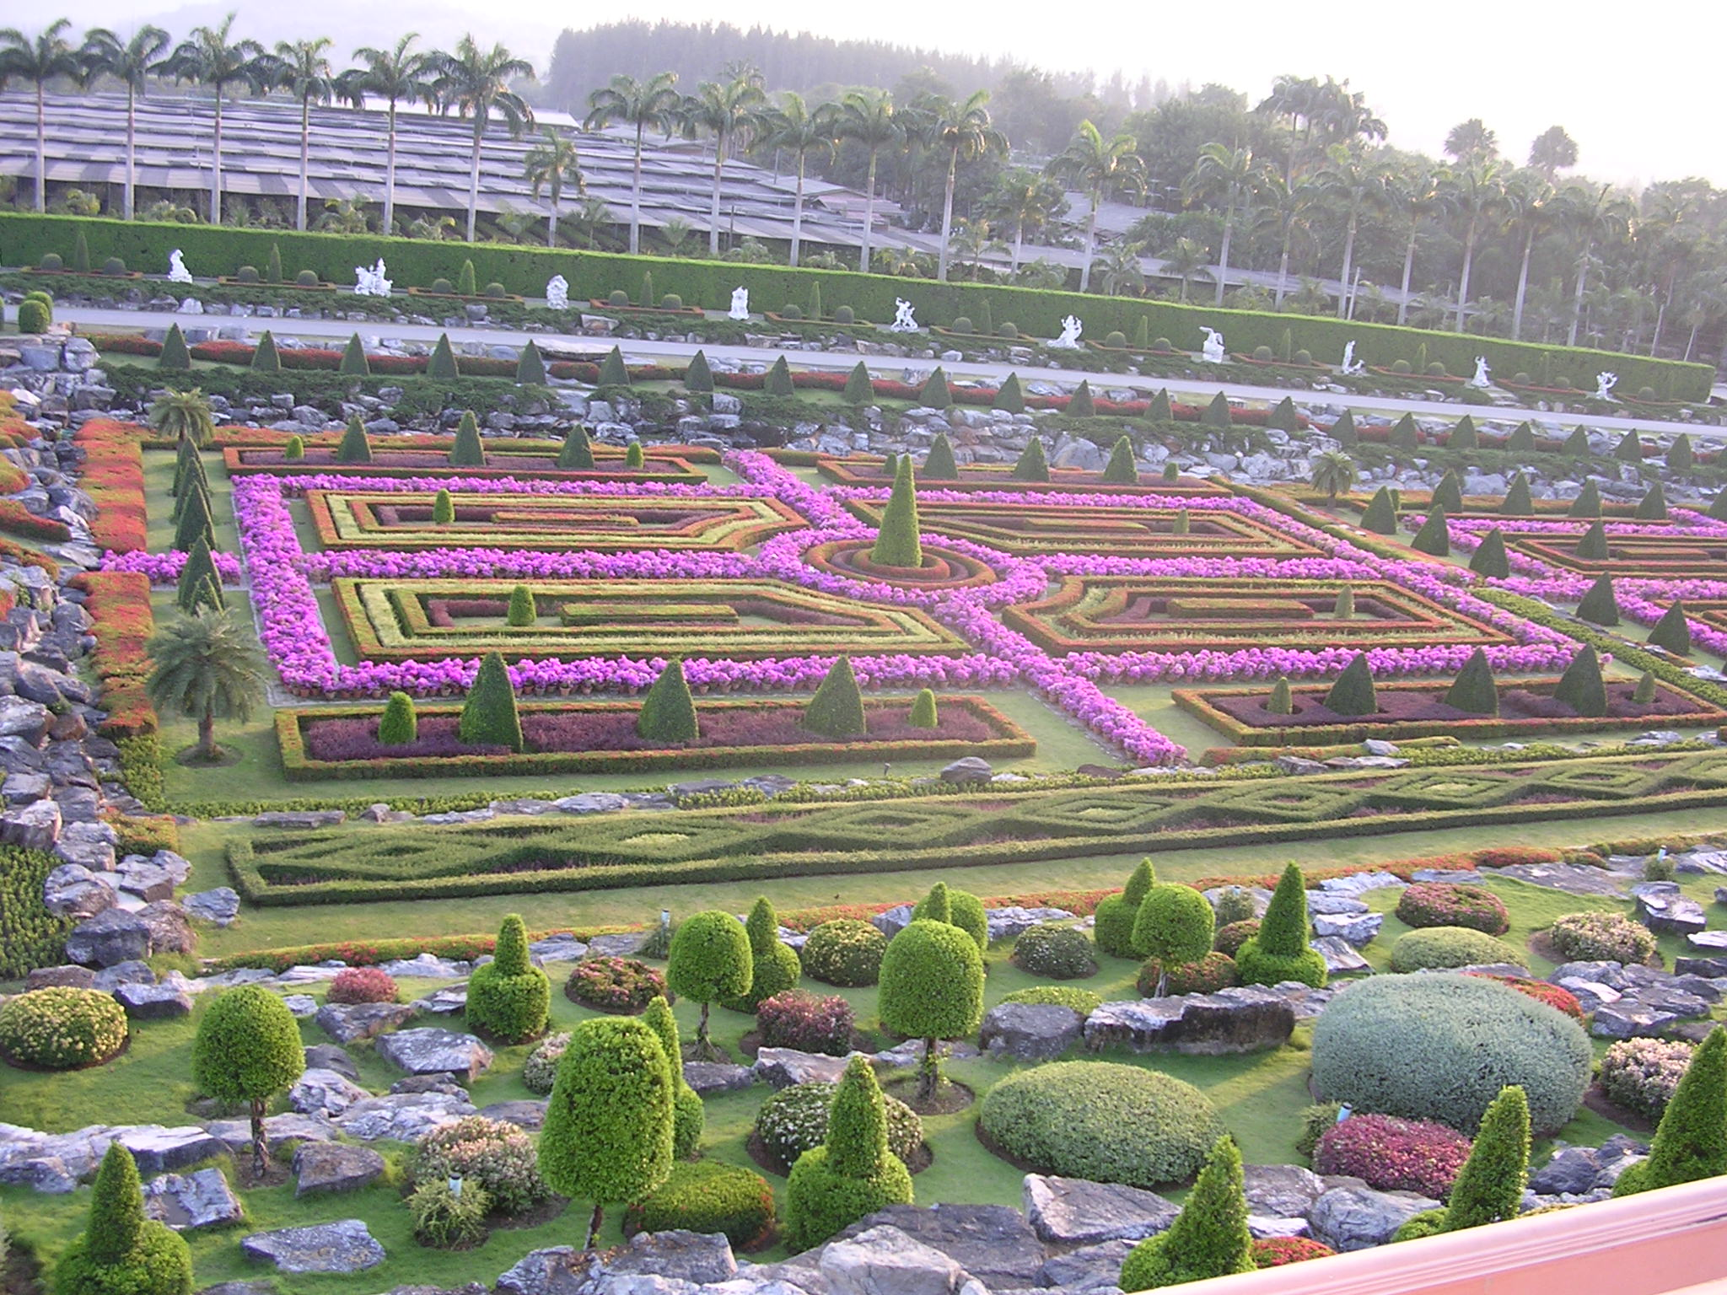
Notes:
Non Nooch

Slide 9
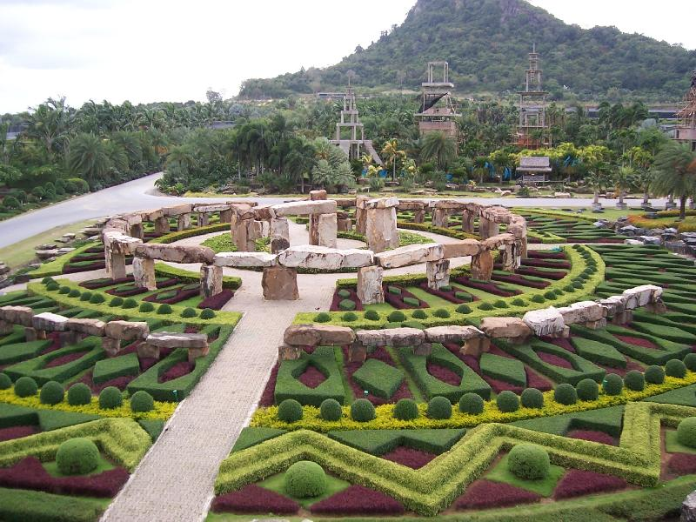
Notes:
Non Nooch

Slide 10
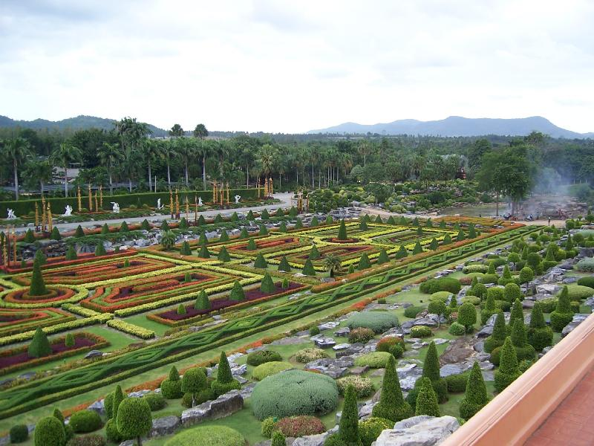
Notes:
Non Nooch

Slide 11
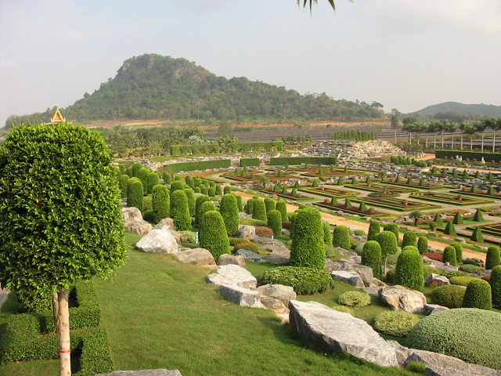
Notes:
Non Nooch

Slide 12

Notes:
Non Nooch

Slide 13
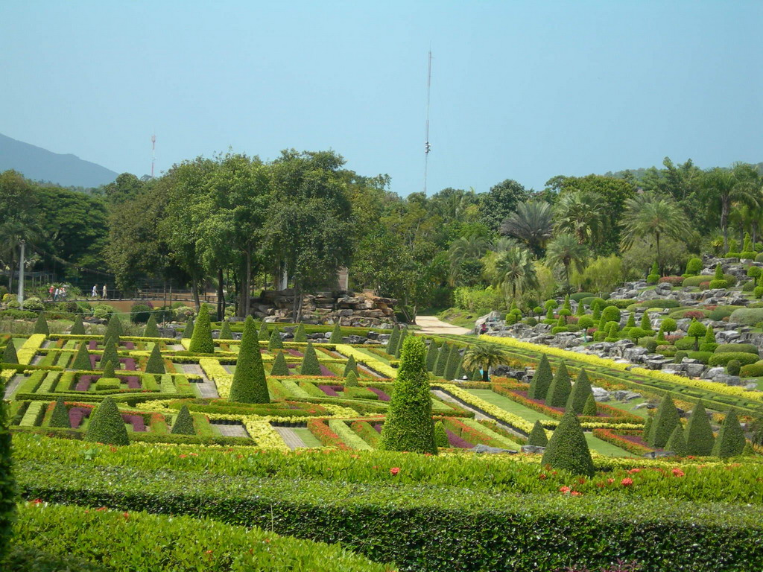
Notes:
Non Nooch

Slide 14
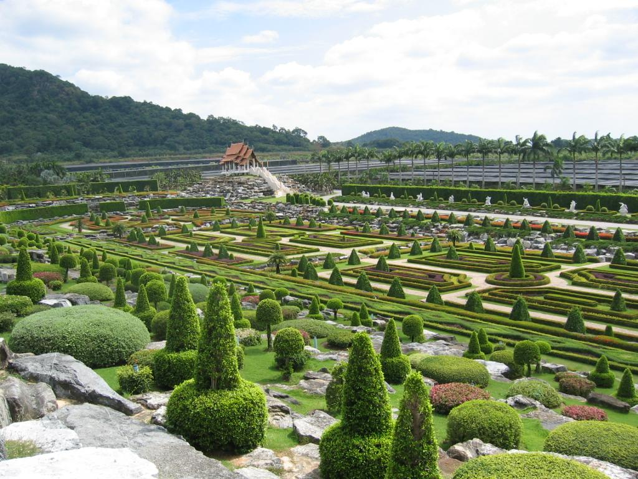
Notes:
Nong Nooch

Slide 15
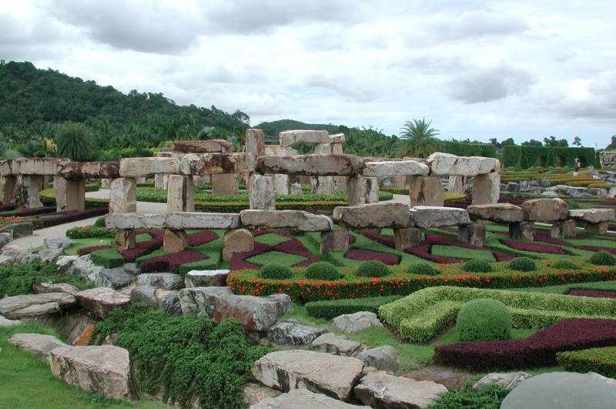
Notes:
Non Nooch

Slide 16
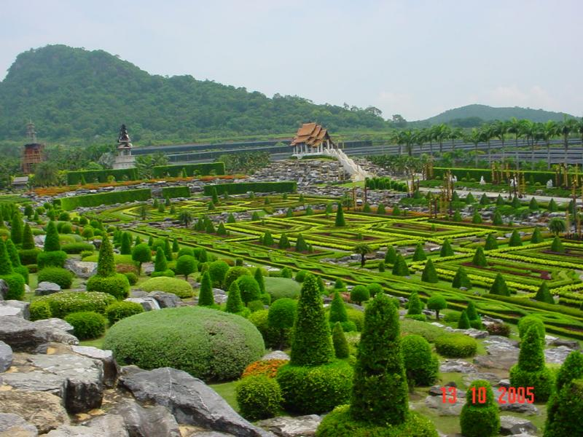
Notes:
Non Nooch

Slide 17
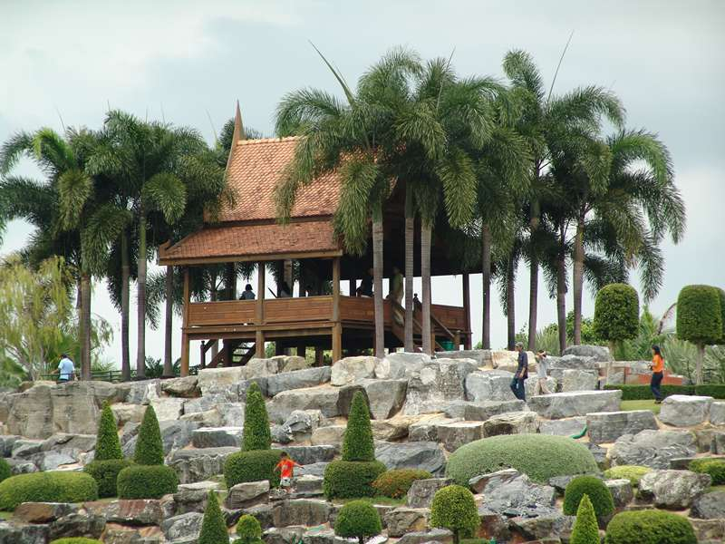
Notes:
Nong Nooch

Slide 18
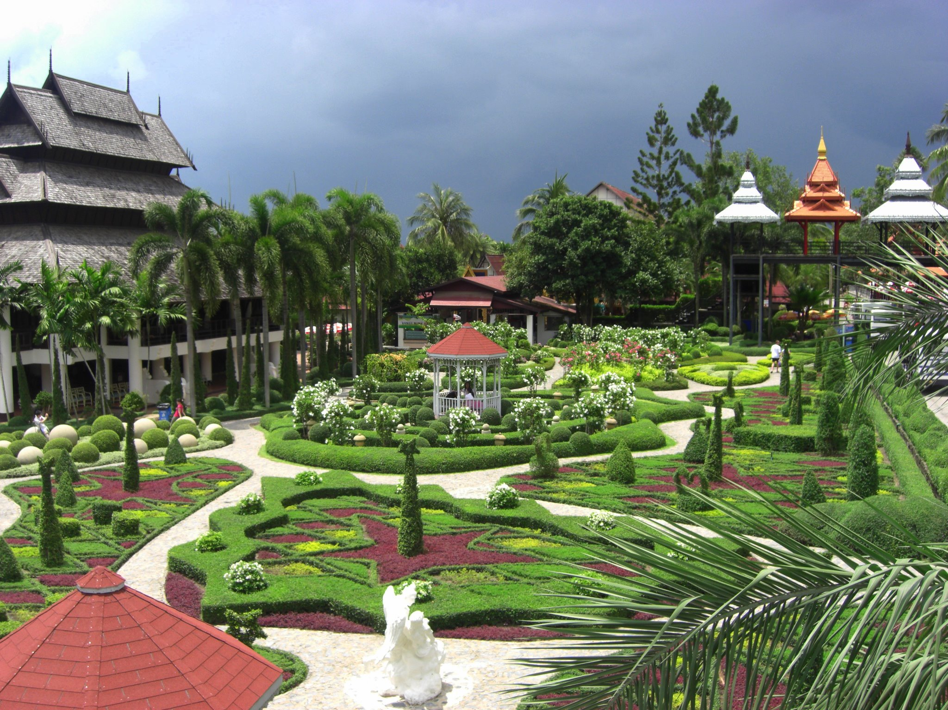
Notes:
Nong Nooch

Slide 19
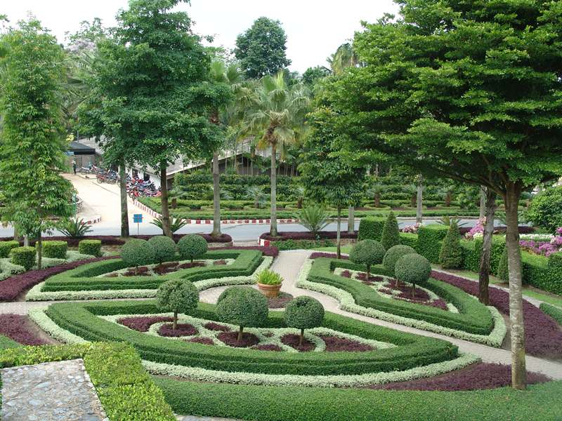
Notes:
Nong Nooch

Slide 20
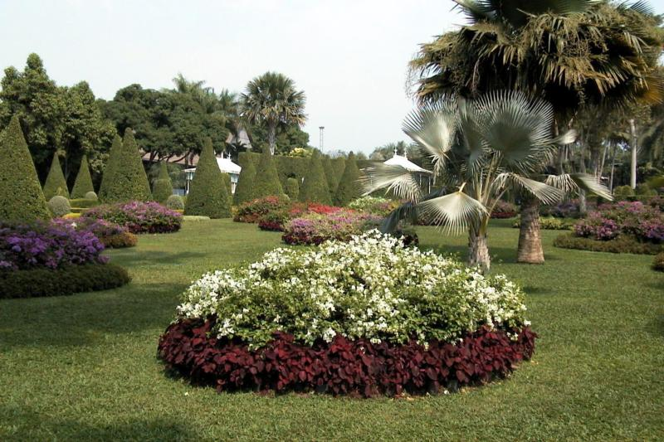
Notes:
Non Nooch

Slide 21
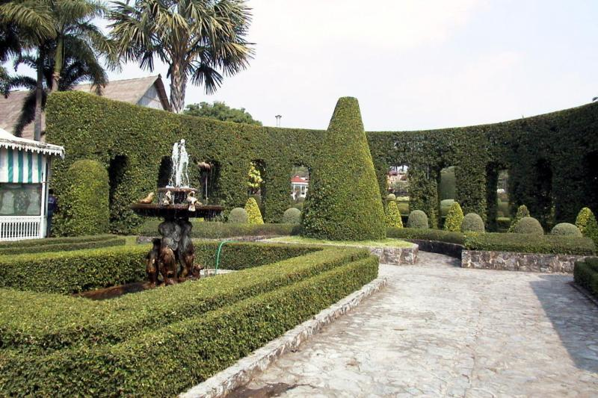
Notes:
Non Nooch

Slide 22
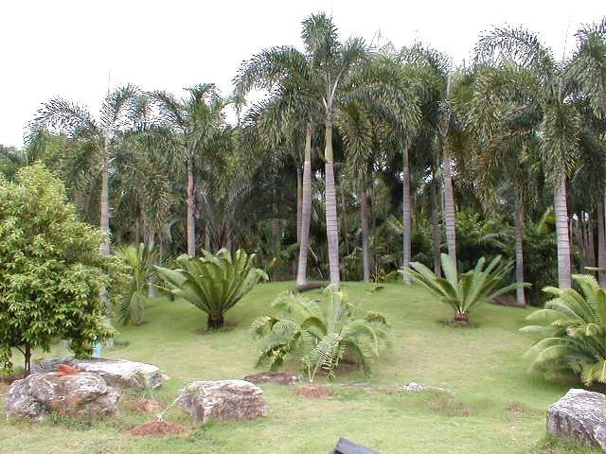
Notes:
Noon Nooch.-Cycas

Slide 23
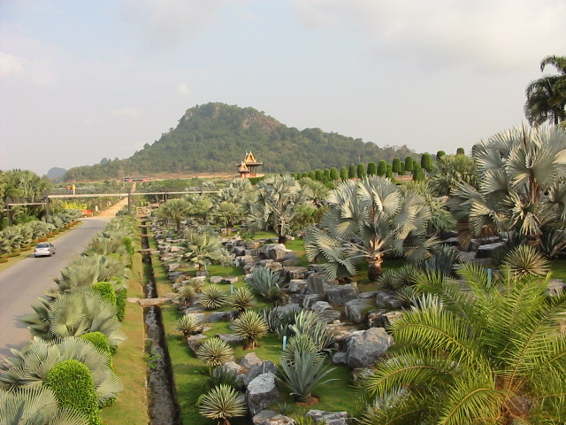
Notes:
Non Nooch

Slide 24
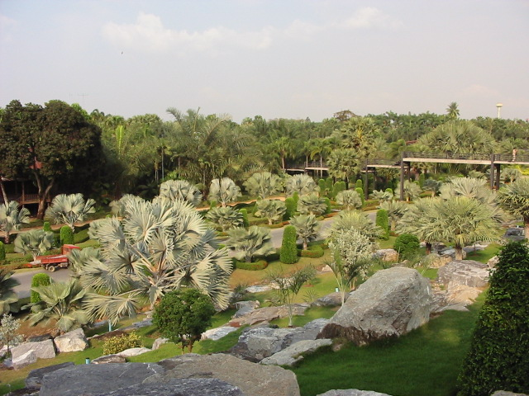
Notes:
Noon Nooch.-Bismarkias

Slide 25
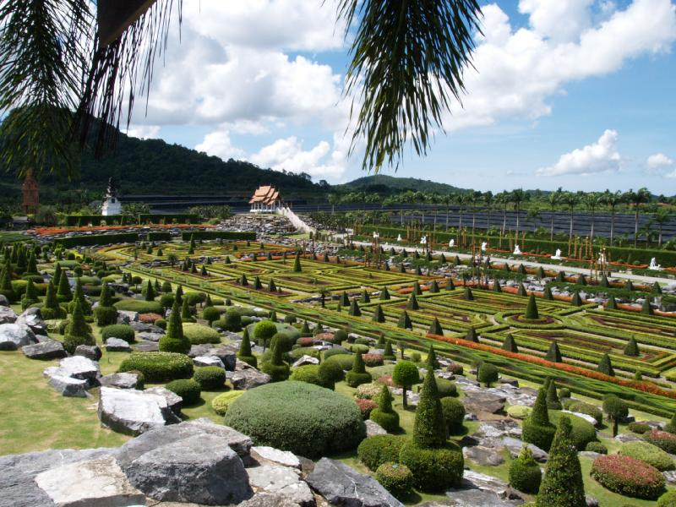
Notes:
Nong Noogh Tropical Garden.-Pattaya

Slide 26
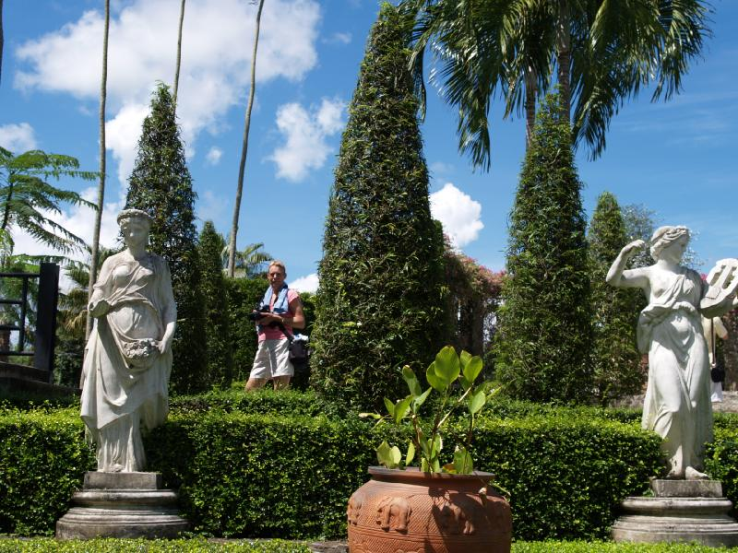
Notes:
Nong Noogh Tropical Garden

Slide 27
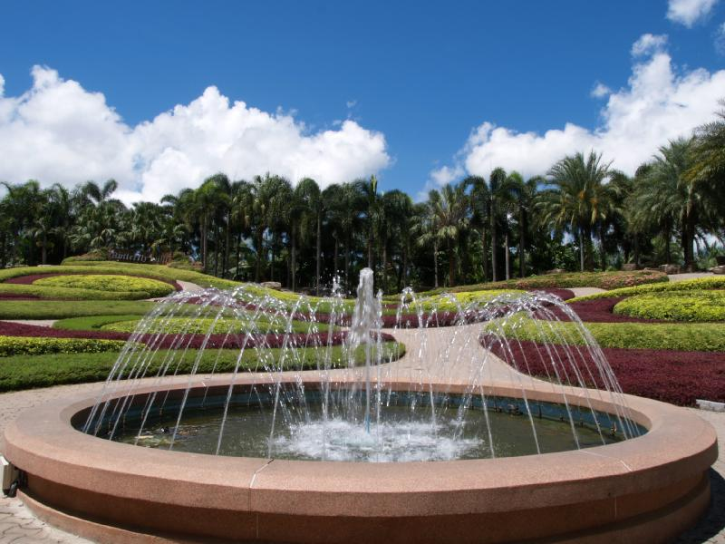
Notes:
Nong Noogh Tropical Garden

Slide 28

Notes:
Nong Noogh Tropical Gardens

Slide 29

Notes:
Nong Noogh Tropical Gardens

Slide 30
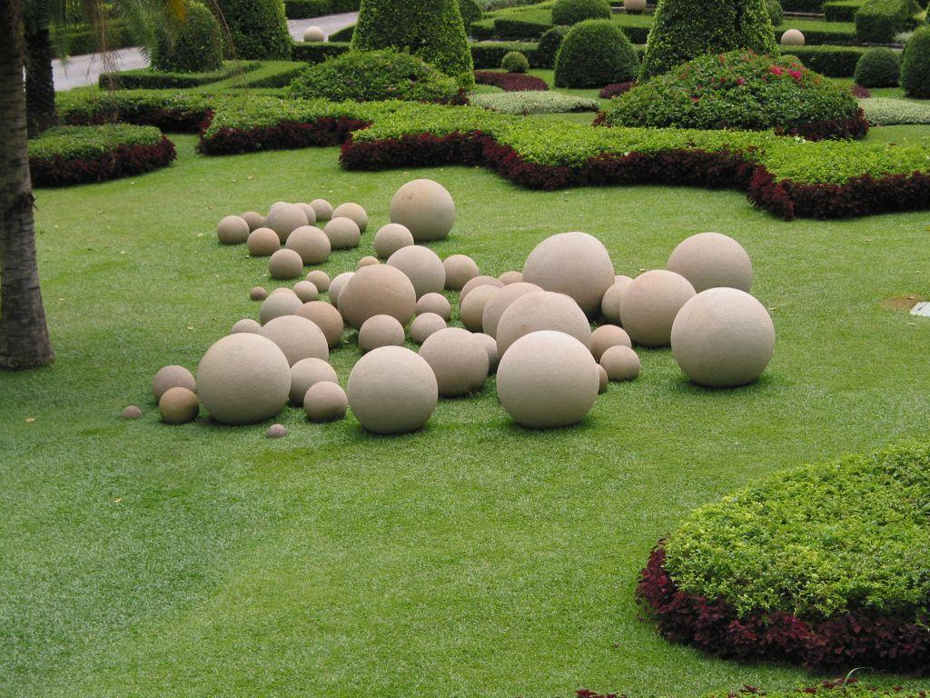
Notes:
Nong Noogh Tropical Gardens.-Bolos de piedra

Slide 31

Notes:
Nong Noogh Tropical Gardens

Slide 32
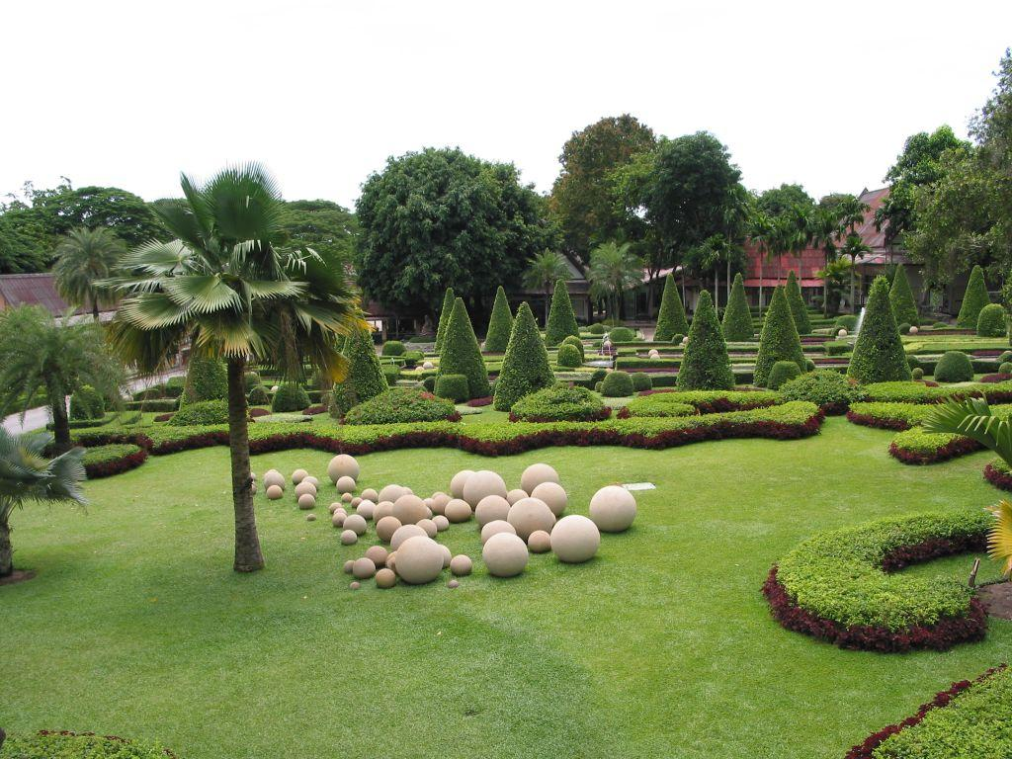
Notes:
Nong Noogh Tropical Gardens

Slide 33

Notes:
Nong Noogh Tropical Gardens

Slide 34

Notes:
Non Nooch

Slide 35
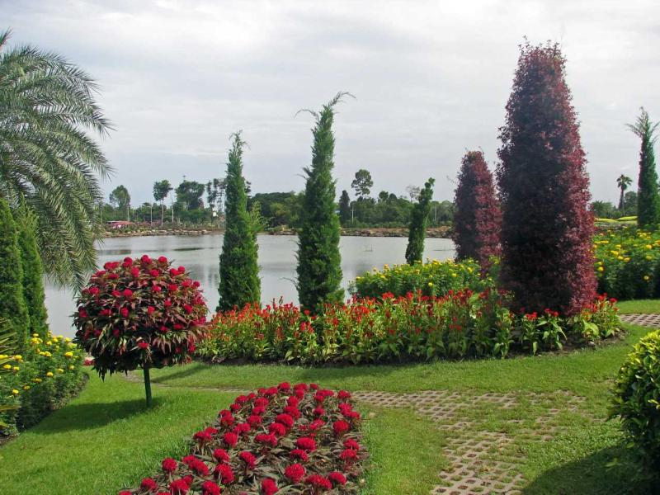
Notes:
Non Nooch

Slide 36
Notes:
Non Nooch

Slide 37
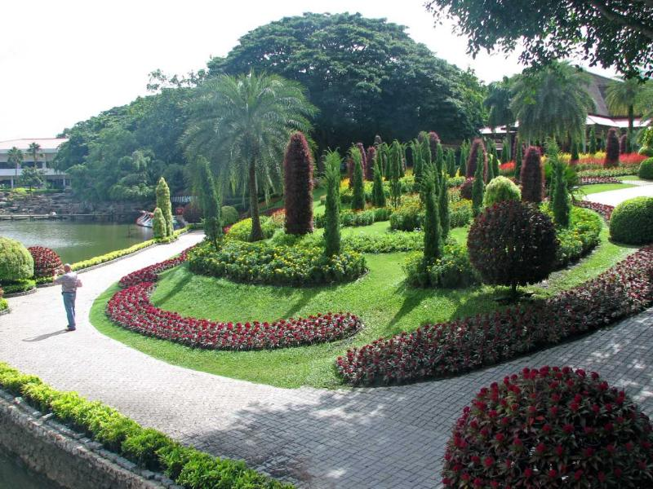
Notes:
Non Nooch

Slide 38
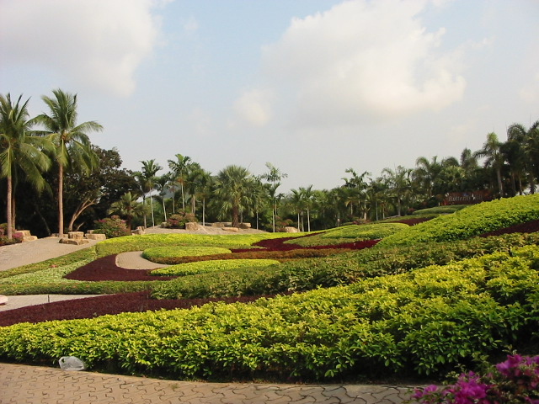
Notes:
Non Nooch

Slide 39
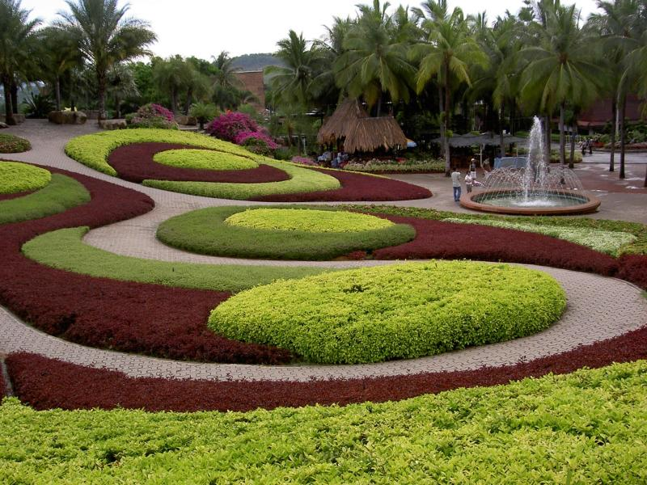
Notes:
Non Nooch

Slide 40
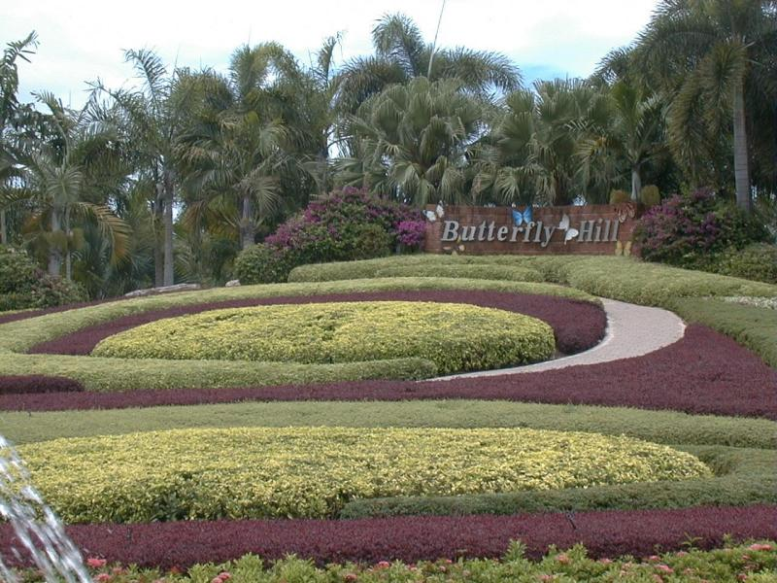
Notes:
Non Nooch

Slide 41
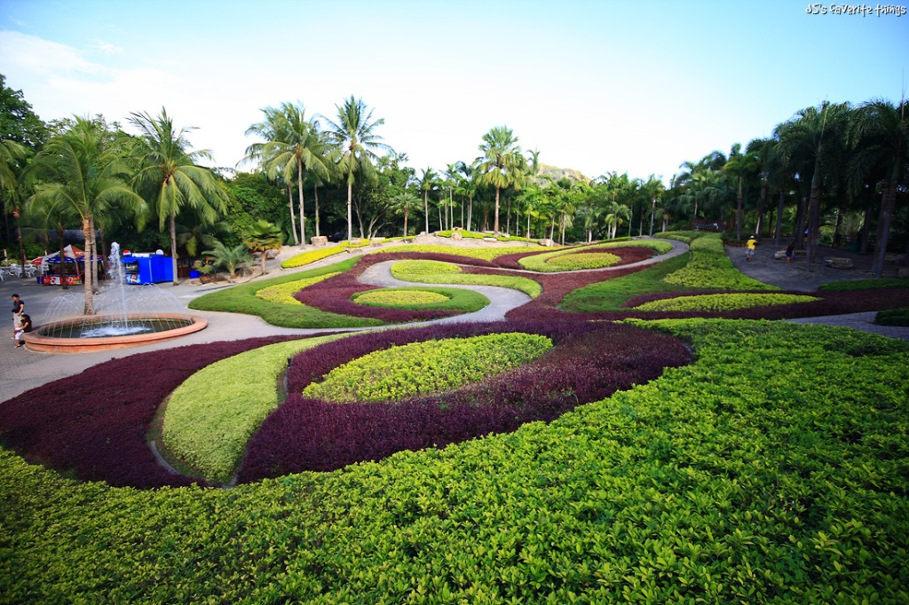
Notes:
Nong Nooch

Slide 42
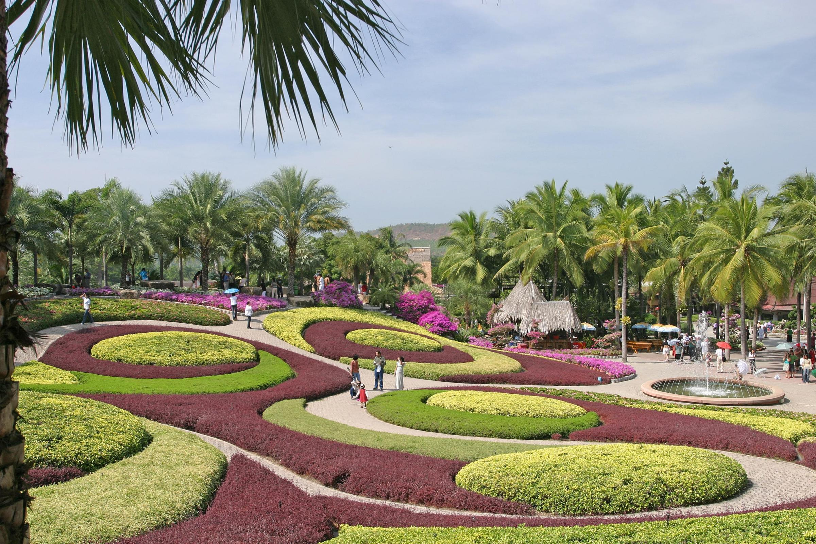
Notes:
Nong Nooch

Slide 43

Notes:
Non Nooch

Slide 44
Notes:
Non Nooch

Slide 45
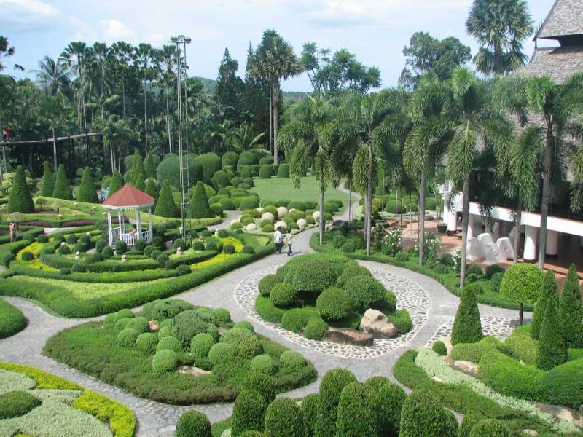
Notes:
Non Nooch

Slide 46
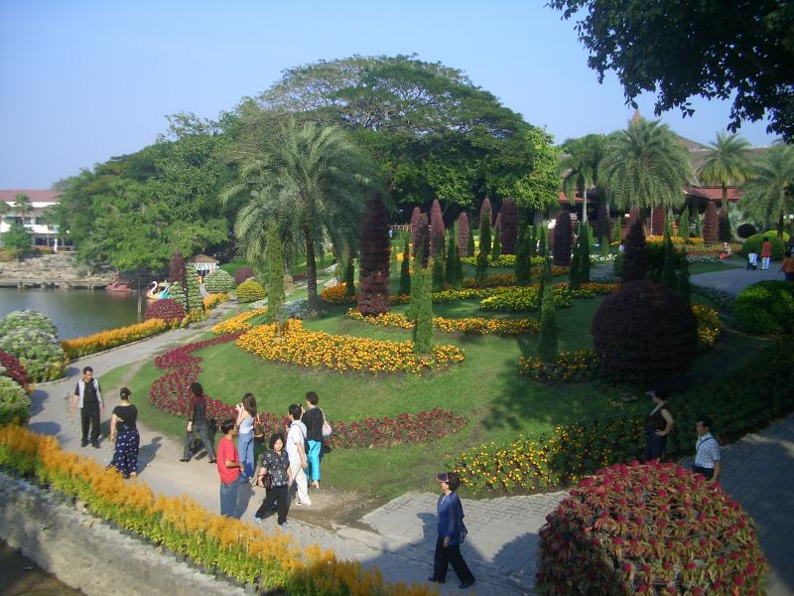
Notes:
Non Nooch

Slide 47
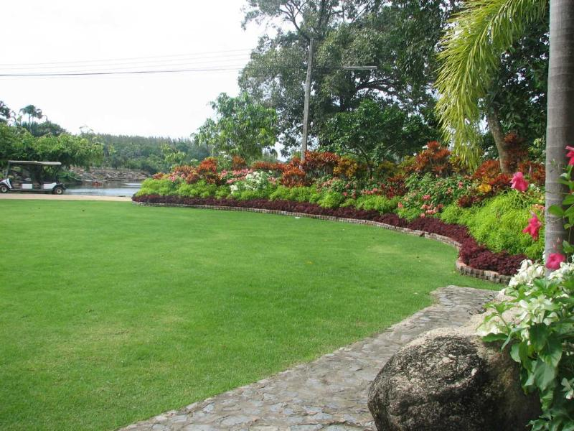
Notes:
Non Nooch

Slide 48

Notes:
Nong Nooch

Slide 49
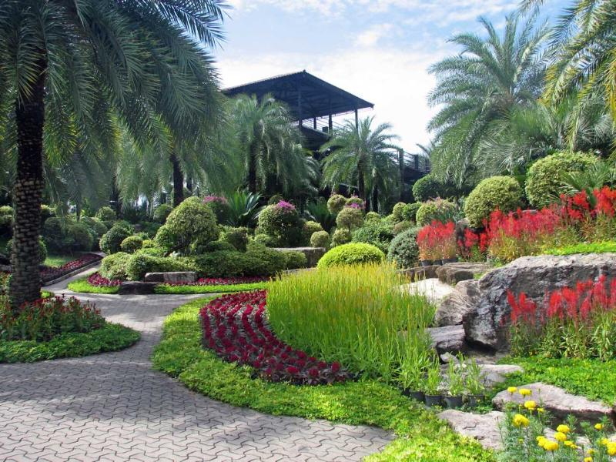
Notes:
Non Nooch

Slide 50
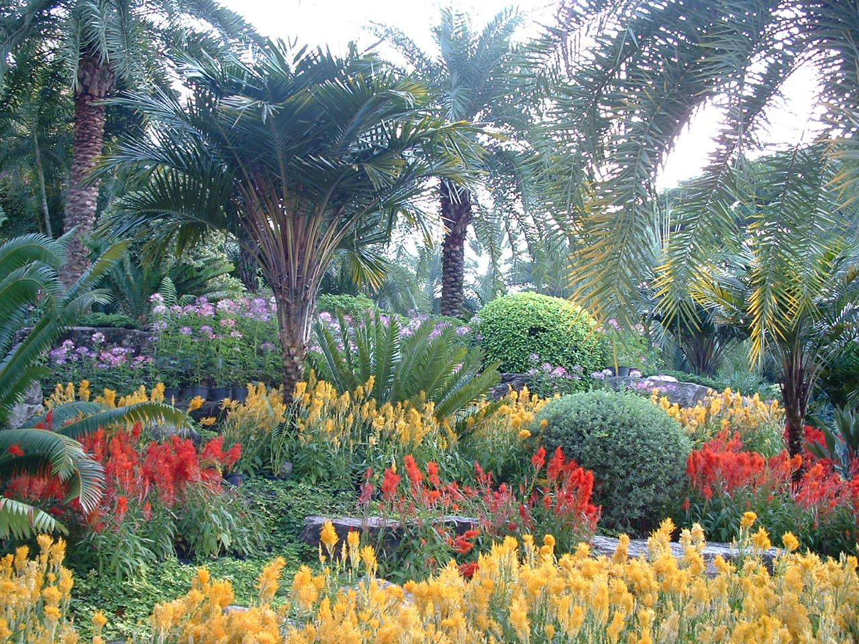
Notes:
Nong Nooch

Slide 51
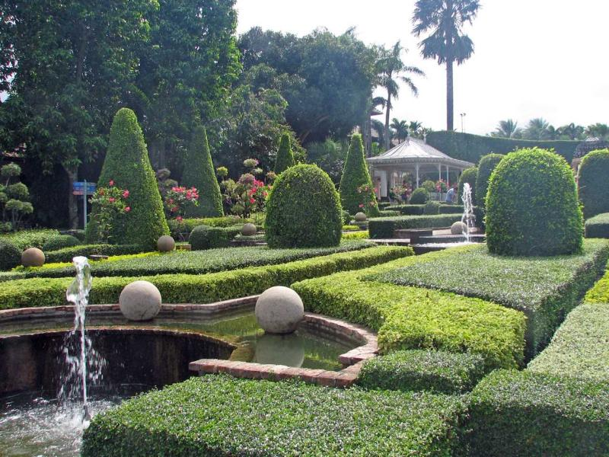
Notes:
Non Nooch

Slide 52
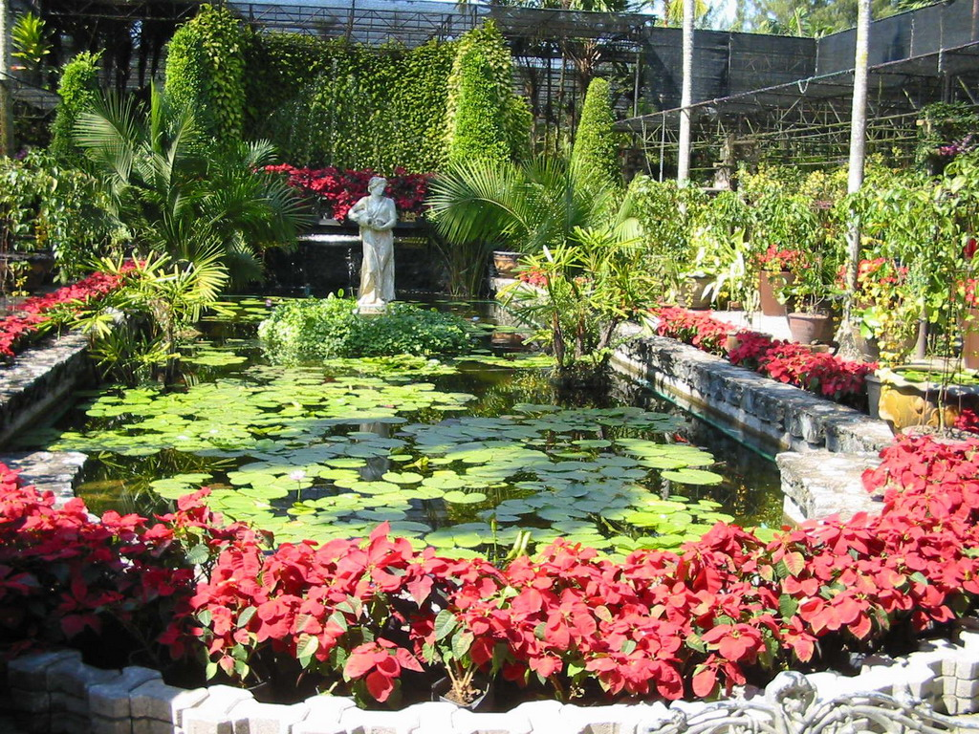
Notes:
Nong Nooch

Slide 53
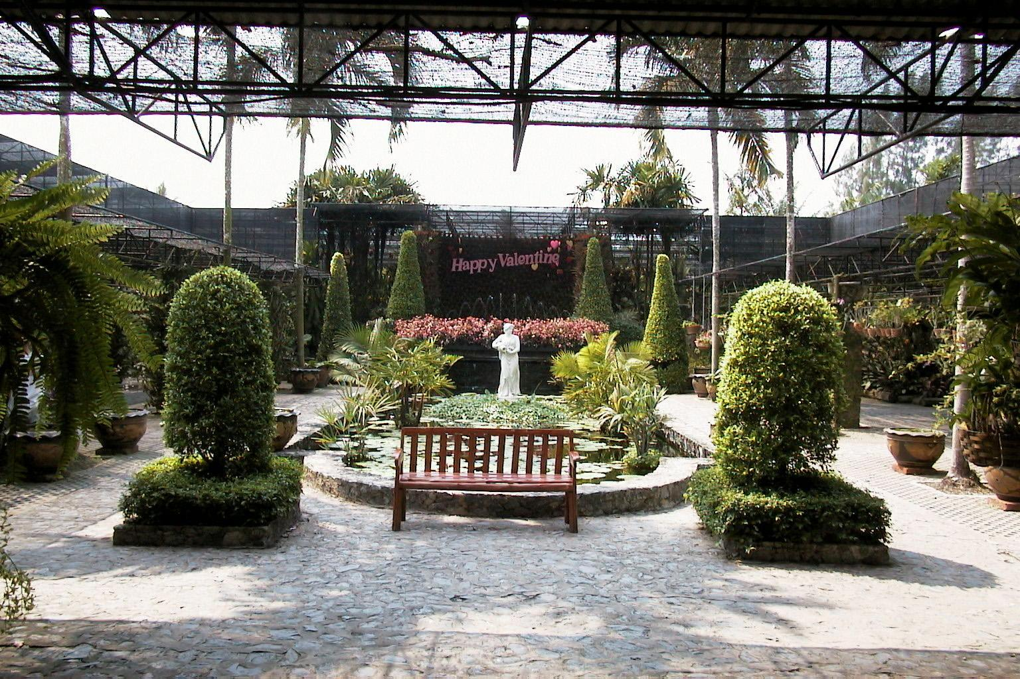
Notes:
Nong Nooch

Slide 54
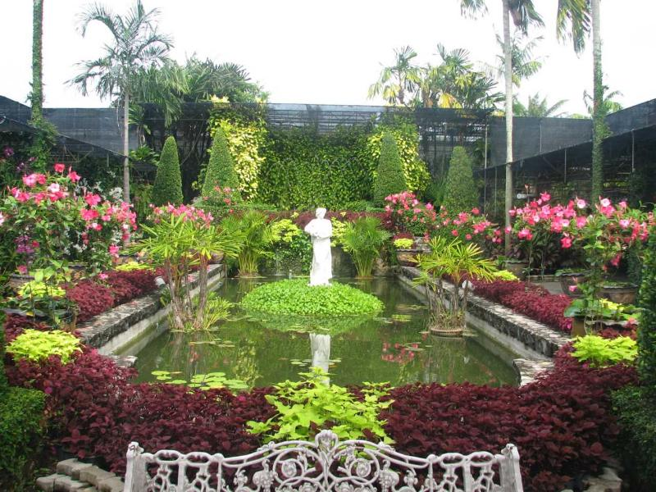
Notes:
Non Nooch

Slide 55
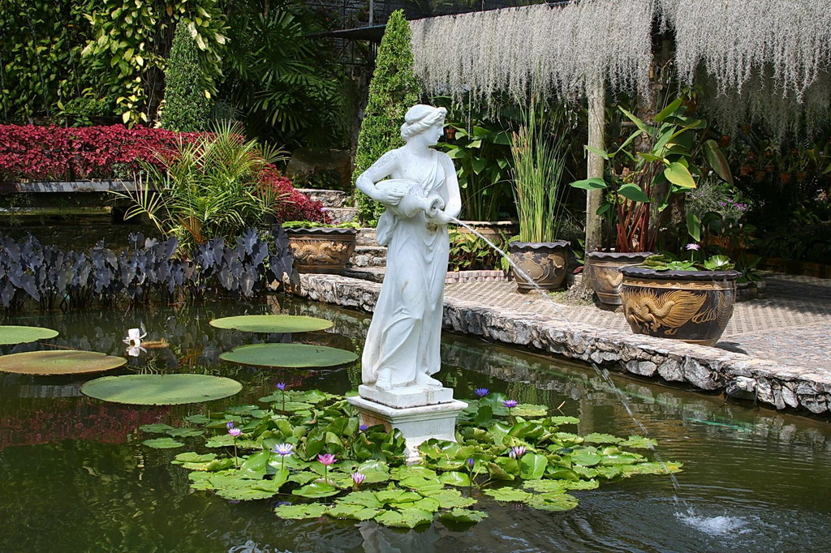
Notes:
Nong Nooch

Slide 56

Notes:
Non Nooch

Slide 57
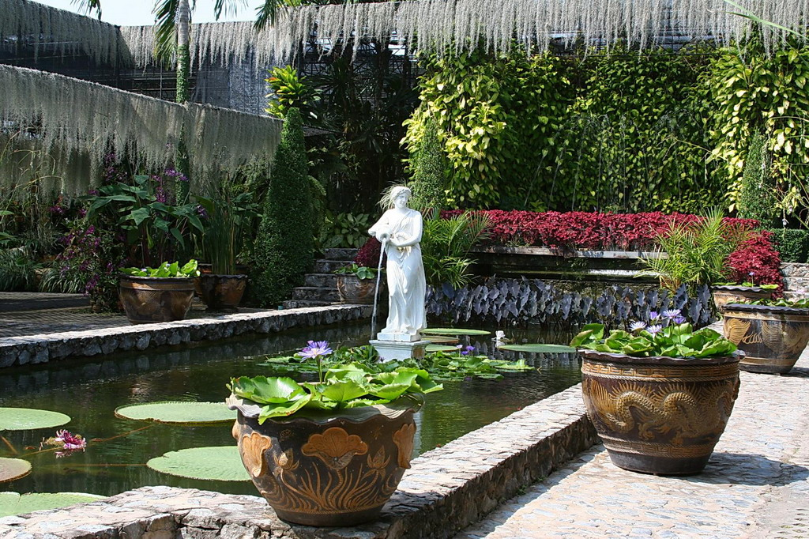
Notes:
Nong Nooch

Slide 58
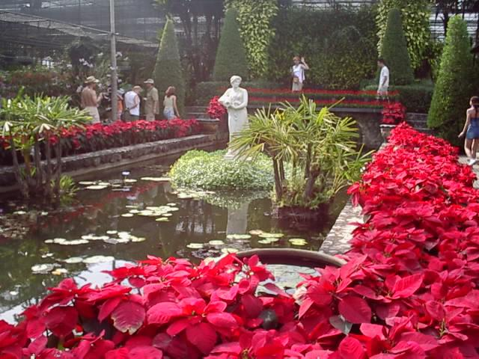
Notes:
Nong Nooch

Slide 59
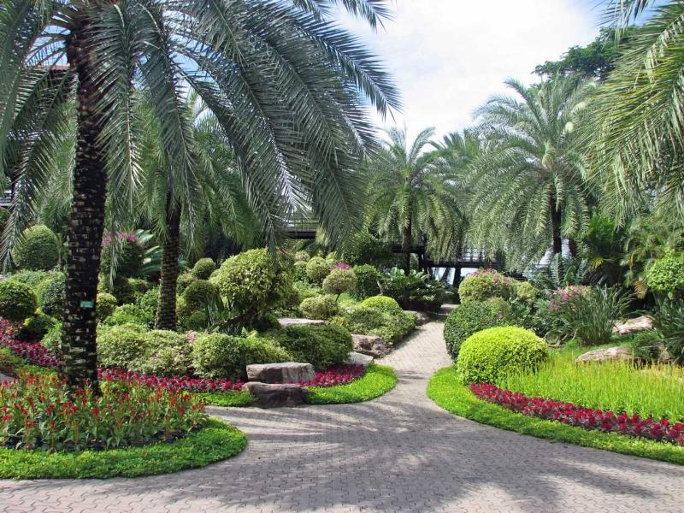
Notes:
Non Nooch

Slide 60
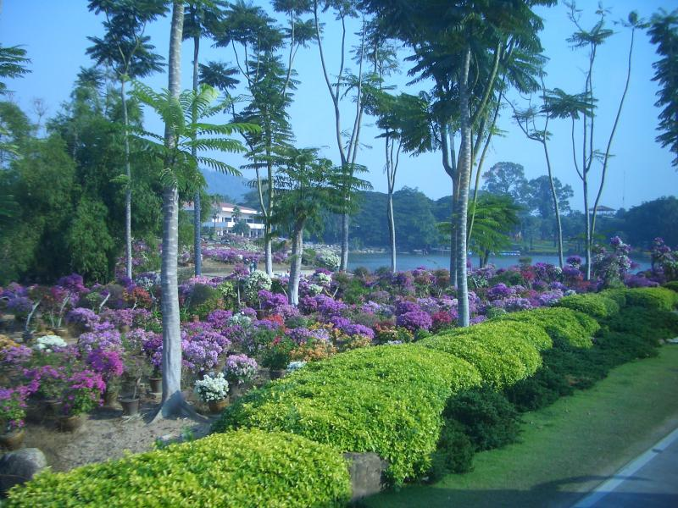
Notes:
Non Nooch

Slide 61
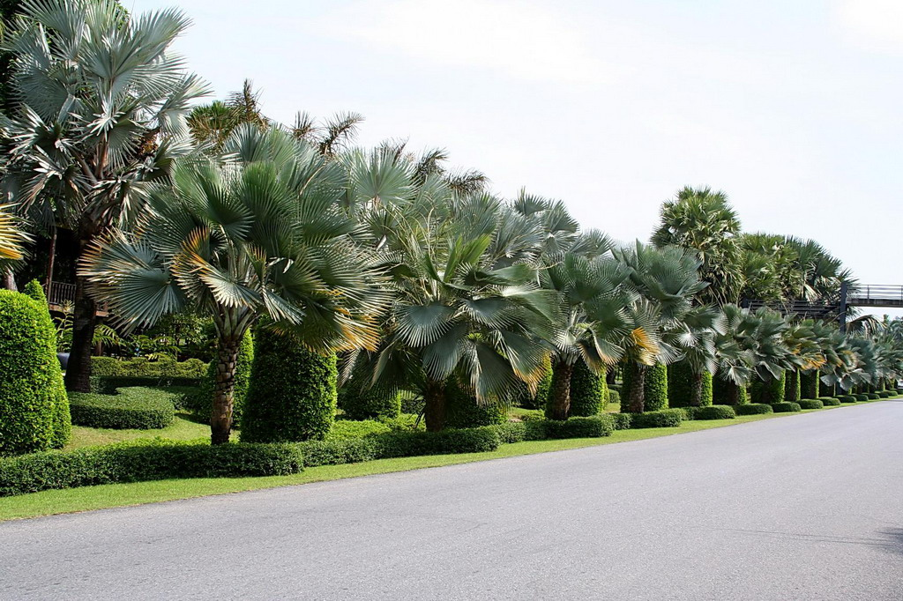
Notes:
Nong Nooch

Slide 62
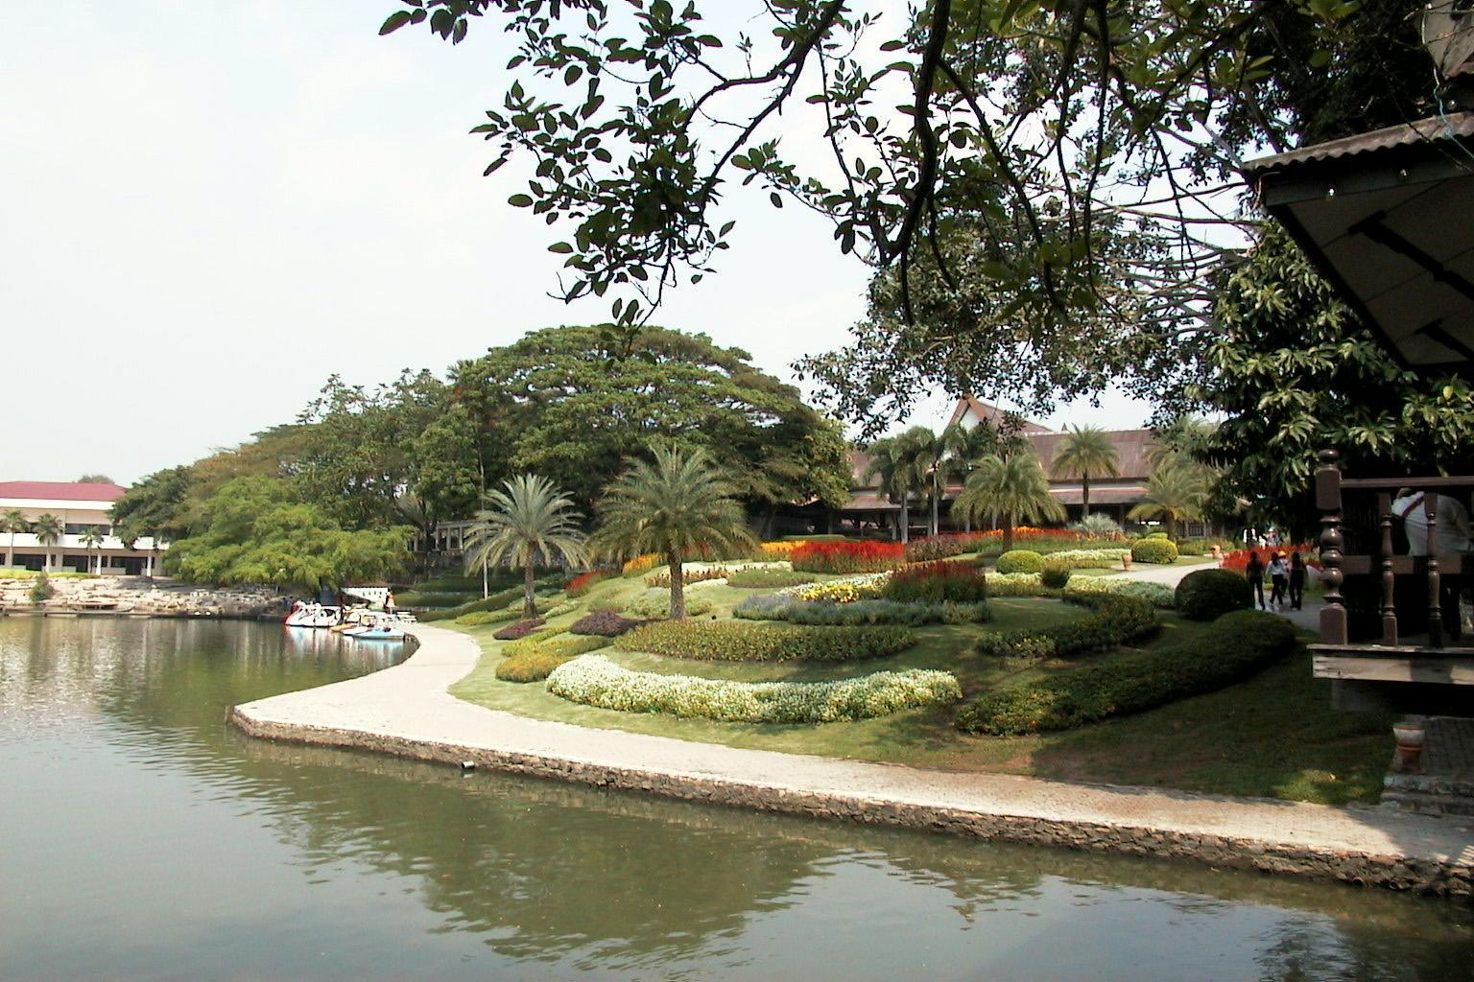
Notes:
Nong Nooch

Slide 63
Notes:
Nong Nooch

Slide 64
Notes:
Nong Nooch

Slide 65
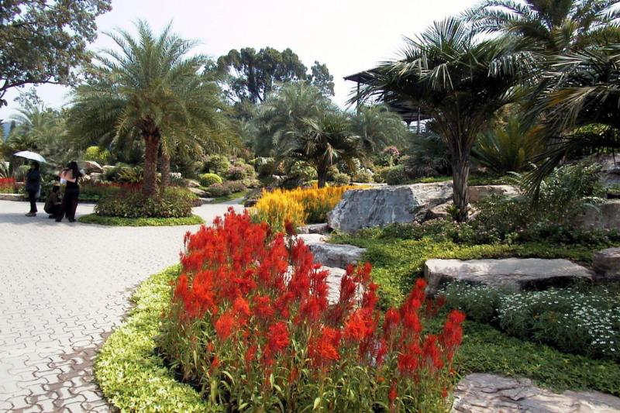
Notes:
Nong Nooch

Slide 66
Notes:
Nong Nooch

Slide 67
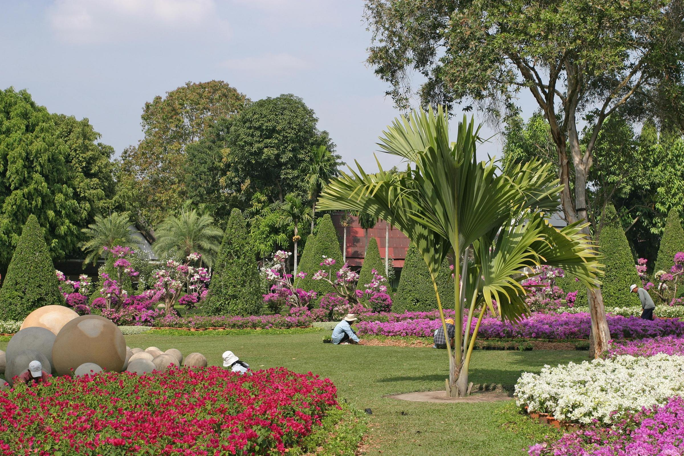
Notes:
Nong Nooch

Slide 68

Notes:
Nong Nooch

Slide 69

Notes:
Nong Nooch

Slide 70

Notes:
Nong Nooch

Slide 71

Notes:
Nong Nooch

Slide 72

Notes:
Non Nooch

Slide 73

Notes:
Nong Nooch.-Celosia

Slide 74

Notes:
Nong Nooch

Slide 75

Notes:
Nong Nooch

Slide 76

Notes:
Nong Nooch

Slide 77

Notes:
Nong Nooch

Slide 78

Notes:
Nong Nooch

Slide 79

Notes:
Nong Nooch

Slide 80

Notes:
Nong Nooch

Slide 81

Notes:
Nong Nooch

Slide 82

Notes:
Nong Nooch

Slide 83

Notes:
Noon Nooch Tropical Gardens.-Pattaya

Slide 84

Notes:
Noon Nooch Tropical Gardens.-Pattaya

Slide 85
Notes:
Nong Nooch

Slide 86
Notes:
Nong Nooch

Slide 87

Notes:
Noon Nooch Tropical Gardens.-Pattaya

Slide 88
Notes:
Nong Nooch

Slide 89

Notes:
Non Nooch

Slide 90

Notes:
Nong Nooch

Slide 91

Notes:
Nong Nooch

Slide 92
Notes:
Nong Nooch

Slide 93

Notes:
Nong Nooch

Slide 94
Notes:
Nong Nooch

Slide 95

Notes:
Nong Nooch

Slide 96

Notes:
Nong Nooch

Slide 97
Notes:
Non Nooch

Slide 98

Notes:
Nong Nooch

Slide 99
Notes:
Non Nooch

Slide 100

Notes:
Nong Nooch

Slide 101

Notes:
Nong Nooch

Slide 102

Notes:
Nong Nooch

Slide 103

Notes:
Nong Nooch

Slide 104

Notes:
Non Nooch

Slide 105

Notes:
Non Nooch

Slide 106

Notes:
Nong Nooch

Slide 107
Notes:
Nong Nooch

Slide 108

Notes:
Nong Nooch

Slide 109

Notes:
Nong Nooch

Slide 110

Notes:
Nong Nooch

Slide 111
Notes:
Nong nOOCH

Slide 112
Notes:
Nong Nooch

Slide 113

Notes:
Nong Nooch

Slide 114

Notes:
Nong Nooch

Slide 115
Notes:
Nong Nooch

Slide 116

Notes:
Nong Nooch

Slide 117

Notes:
Nong Nooch

Slide 118

Notes:
Nong Nooch

Slide 119

Notes:
Nong Nooch

Slide 120

Notes:
Nong Nooch

Slide 121

Notes:
Nong Nooch

Slide 122

Notes:
Nong Nooch.- Johannesteijsmannia altifrons

Slide 123

Notes:
Nong Nooch.-Bromelias

Slide 124

Notes:
Nong Nooch

Slide 125

Notes:
Nong Nooch

Slide 126

Notes:
Nong Nooch

Slide 127

Notes:
Nong Nooch

Slide 128

Notes:
Nong Nooch

Slide 129

Notes:
Noon Nooch Tropical Gardens.-Pattaya

Slide 130

Notes:
Noon Nooch Tropical Gardens.-Pattaya

Slide 131

Notes:
Noon Nooch Tropical Gardens.-Pattaya

Slide 132

Notes:
Noon Nooch Tropical Gardens.-Pattaya

Slide 133

Notes:
Noon Nooch Tropical Gardens.-Pattaya

Slide 134

Notes:
Noon Nooch Tropical Gardens.-Pattaya

Slide 135

Notes:
Noon Nooch Tropical Gardens.-Pattaya

Slide 136

Notes:
Noon Nooch Tropical Gardens.-Pattaya

Slide 137

Notes:
Noon Nooch Tropical Gardens.-Pattaya.-Streptocalyx

Slide 138

Notes:
Noon Nooch Tropical Gardens.-Pattaya..Bromelias

Slide 139

Notes:
Noon Nooch Tropical Gardens.-Pattaya

Slide 140

Notes:
Noon Nooch Tropical Gardens.-Pattaya
.-Tillantias

Slide 141

Notes:
Noon Nooch Tropical Gardens.-Pattaya.-Bromelias

Slide 142

Notes:
Noon Nooch Tropical Gardens.-Pattaya.-Bromelias

Slide 143

Notes:
Noon Nooch Tropical Gardens.-Pattaya.-Cryptanthus

Slide 144

Notes:
Noon Nooch Tropical Gardens.-Pattaya.-Orquideas

Slide 145

Notes:
Noon Nooch Tropical Gardens.-Pattaya

Slide 146

Notes:
Noon Nooch Tropical Gardens.-Pattaya

Slide 147

Notes:
Noon Nooch Tropical Gardens.-Pattaya.-Dipladenia

Slide 148

Notes:
Noon Nooch Tropical Gardens.-Pattaya

