Slide 1
EUROPA.-LA VUELTA AL MUNDO EN 885 JARDINES.-REINO UNIDO.-
CHELSEA FLOWER SHOW.-2010-13
Selección de textos y fotografías por
JOSE ELIAS BONELLS

Slide 2
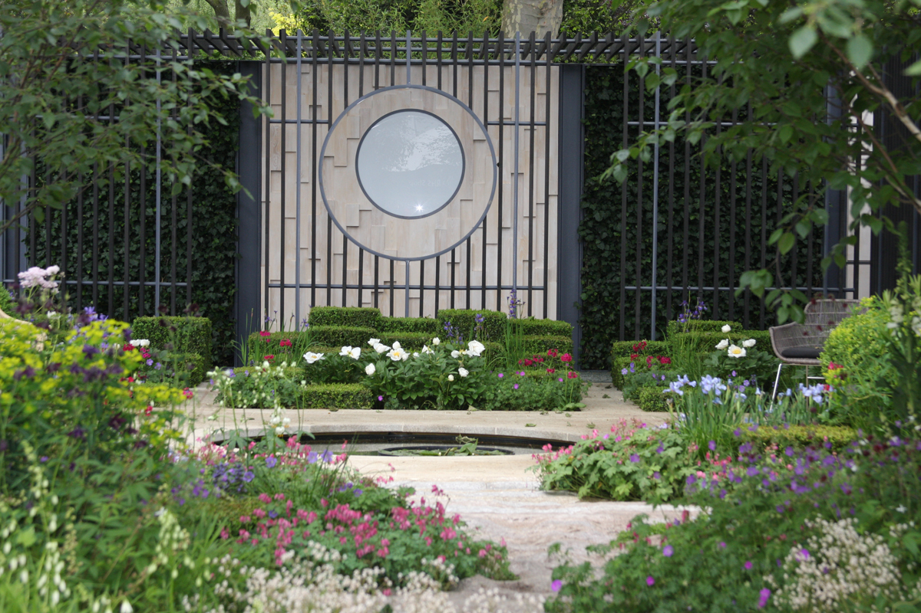
Notes:
Chelsea 2010

Slide 3
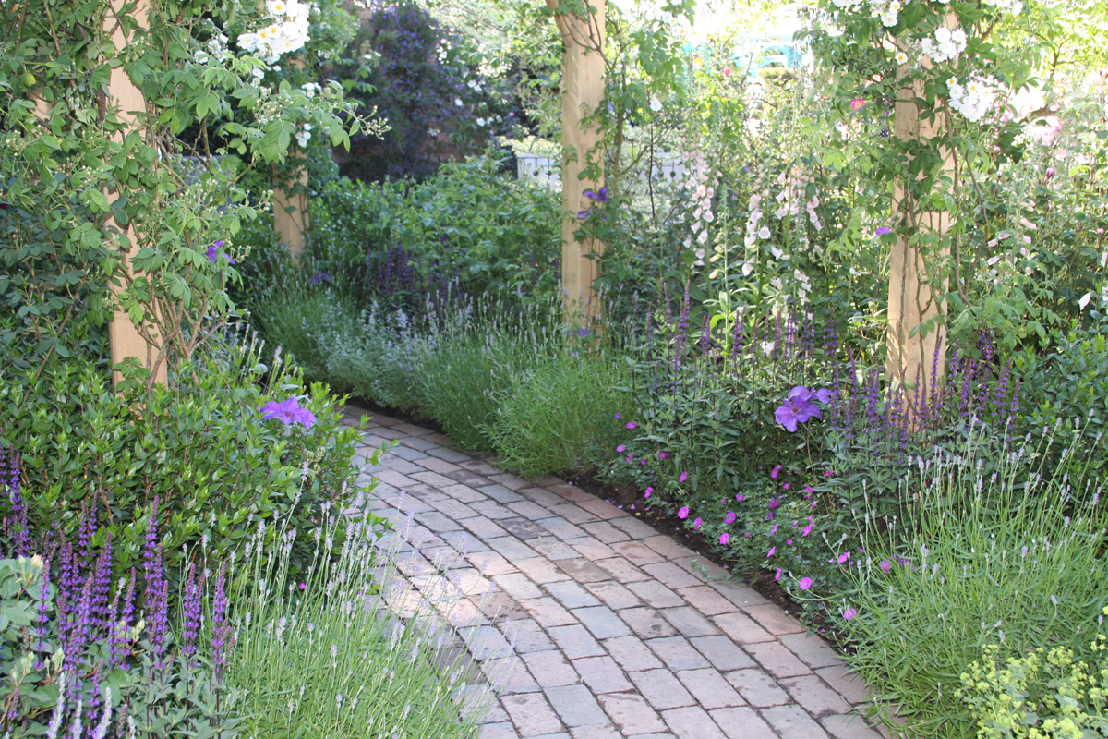
Notes:
Chelsea 2010

Slide 4
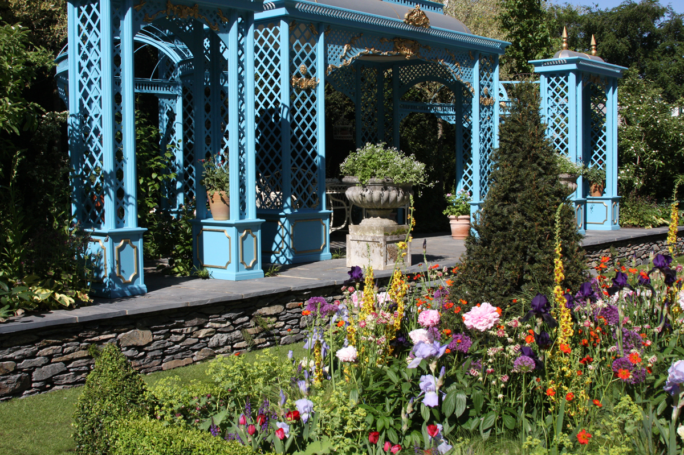
Notes:
Chelsea 2010

Slide 5
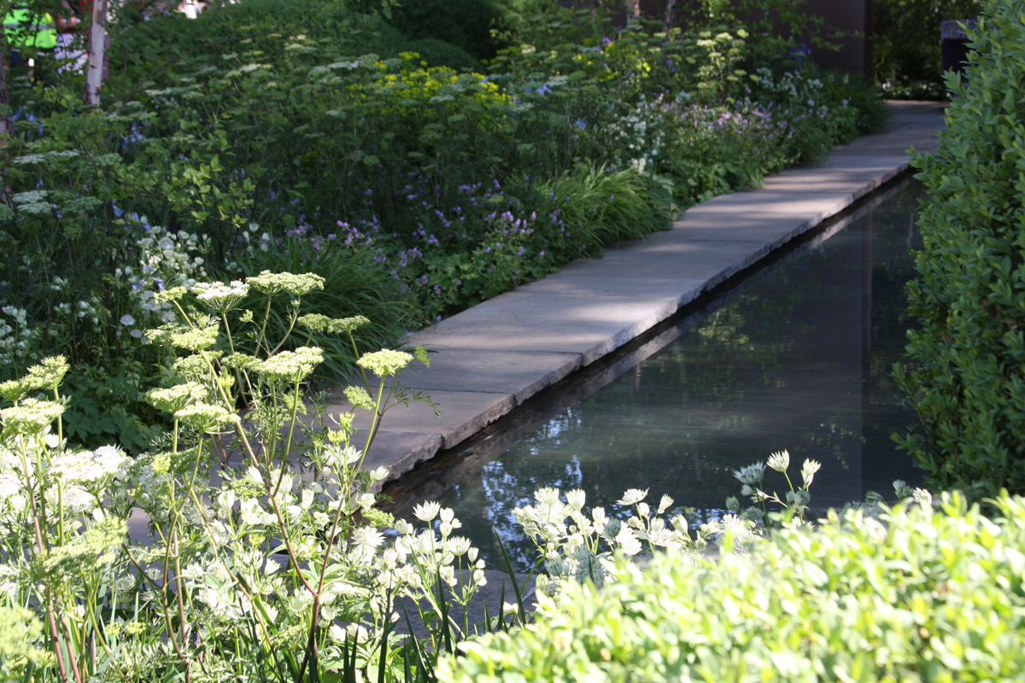
Notes:
Chelsea 2010

Slide 6
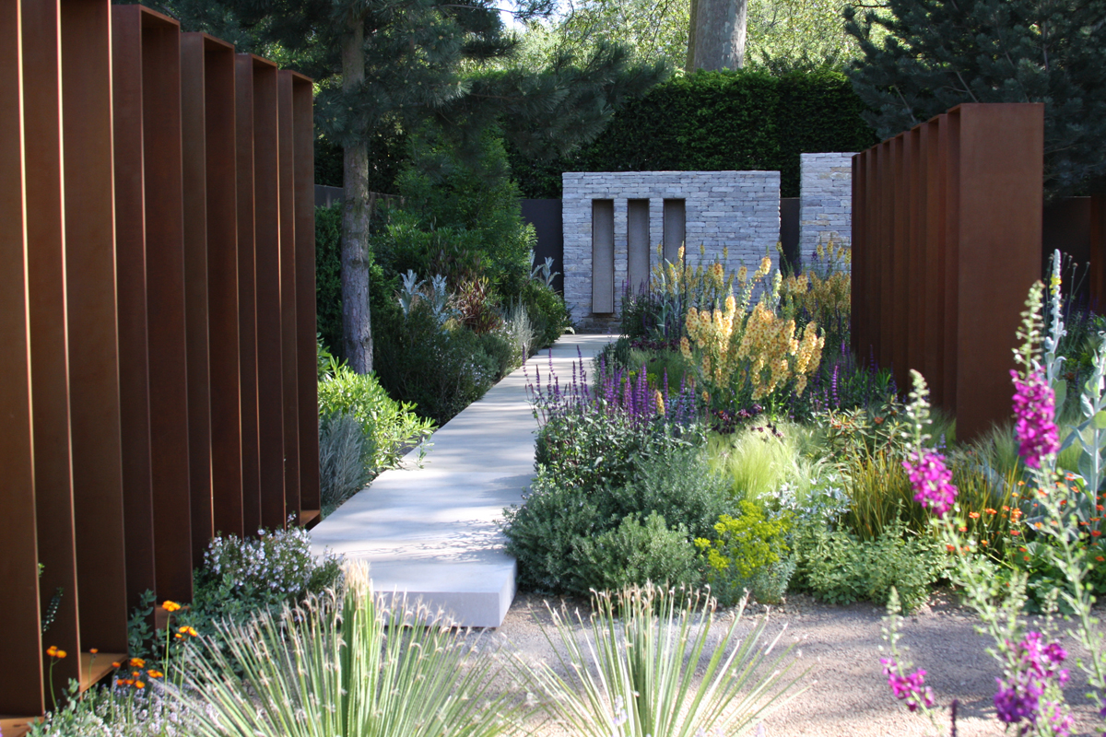
Notes:
Chelsea 2010

Slide 7
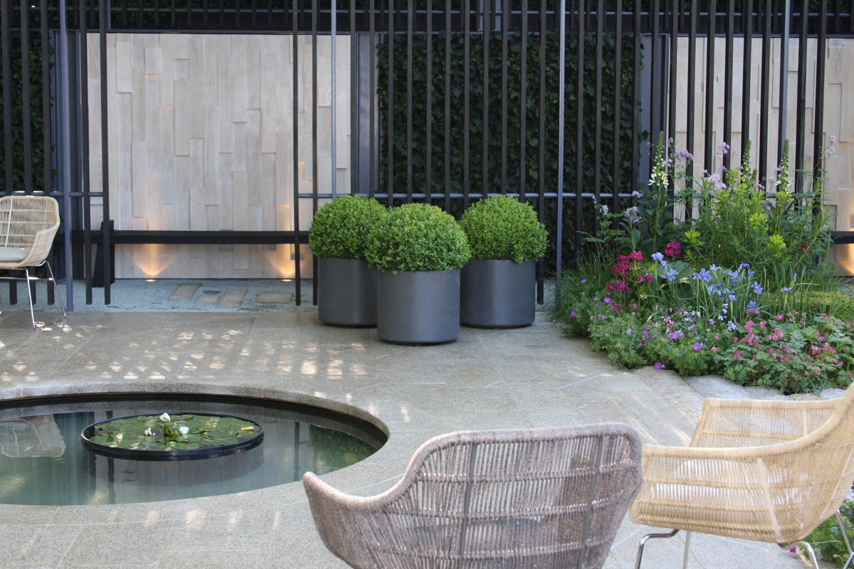
Notes:
Chelsea 2010

Slide 8
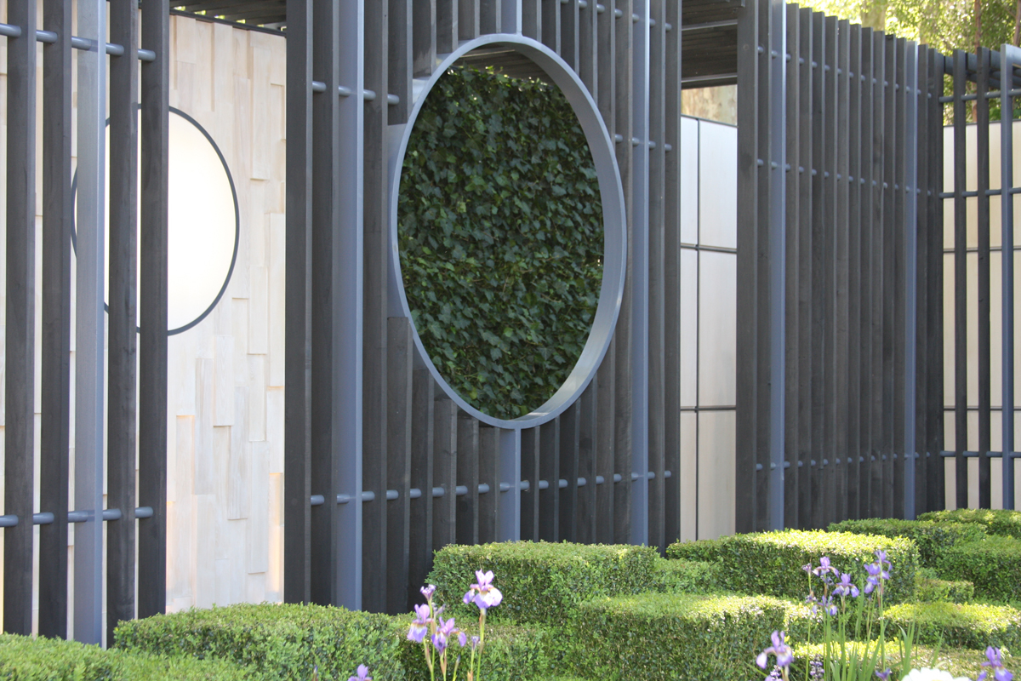
Notes:
Chelsea 2010

Slide 9
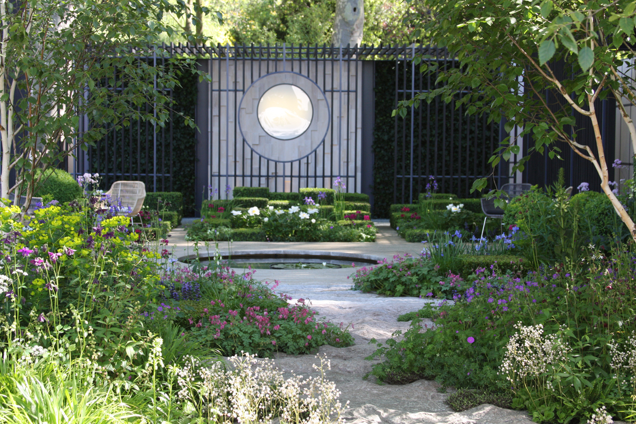
Notes:
Chelsea 2010

Slide 10
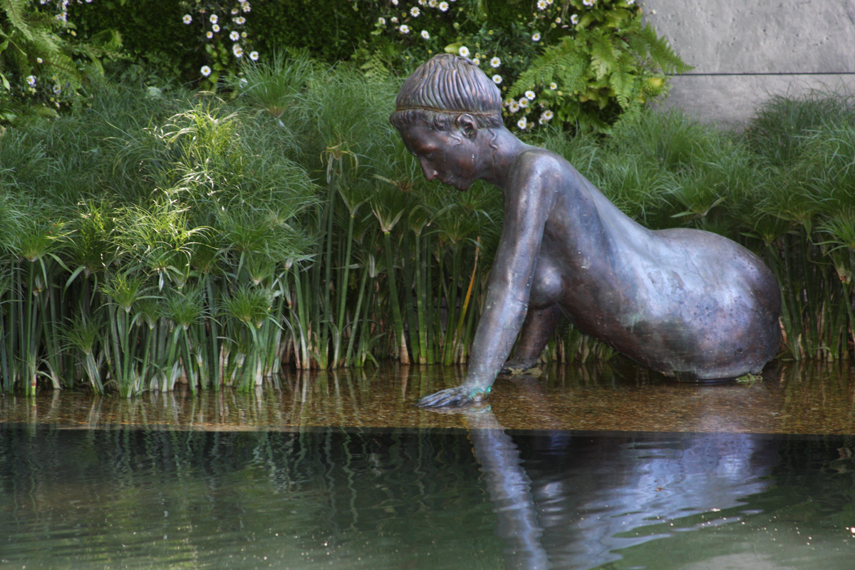
Notes:
Chelsea 2010

Slide 11
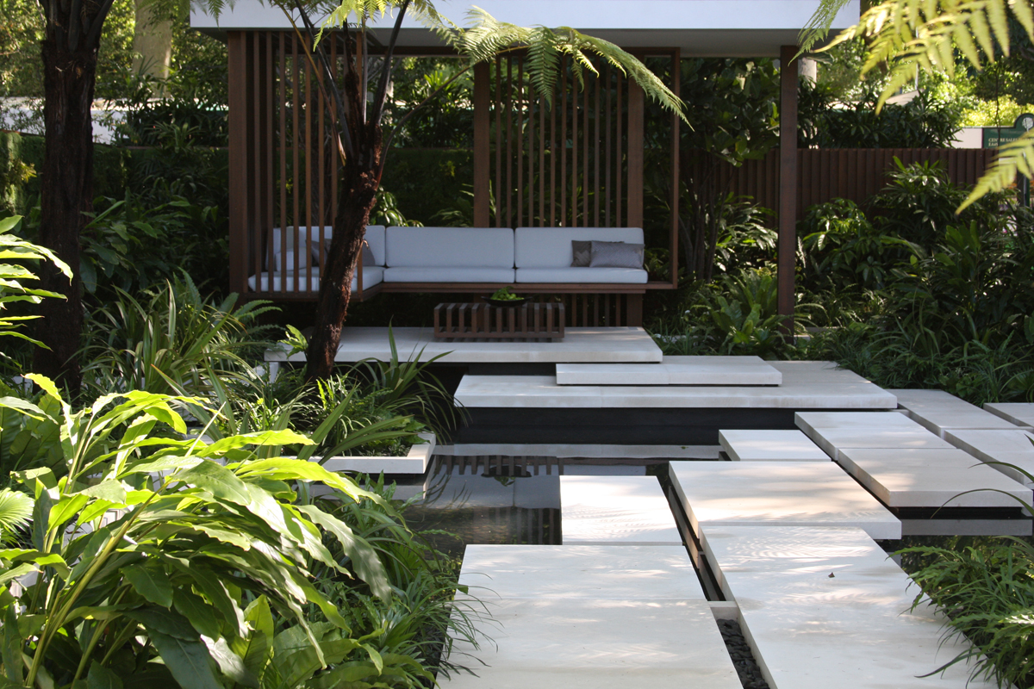
Notes:
Chelsea 2010

Slide 12
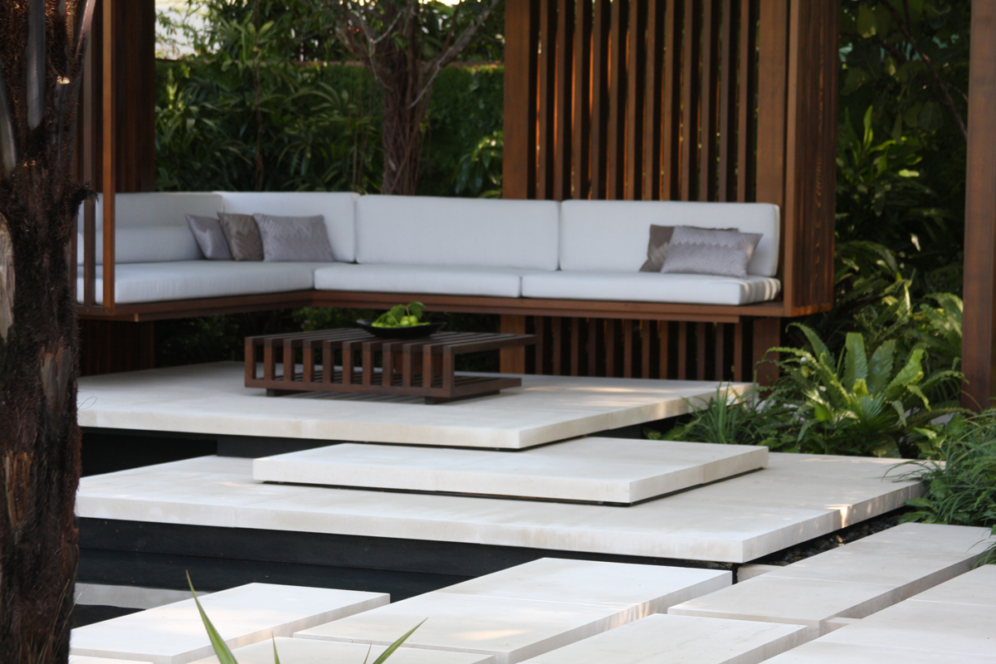
Notes:
Chelsea 2010

Slide 13
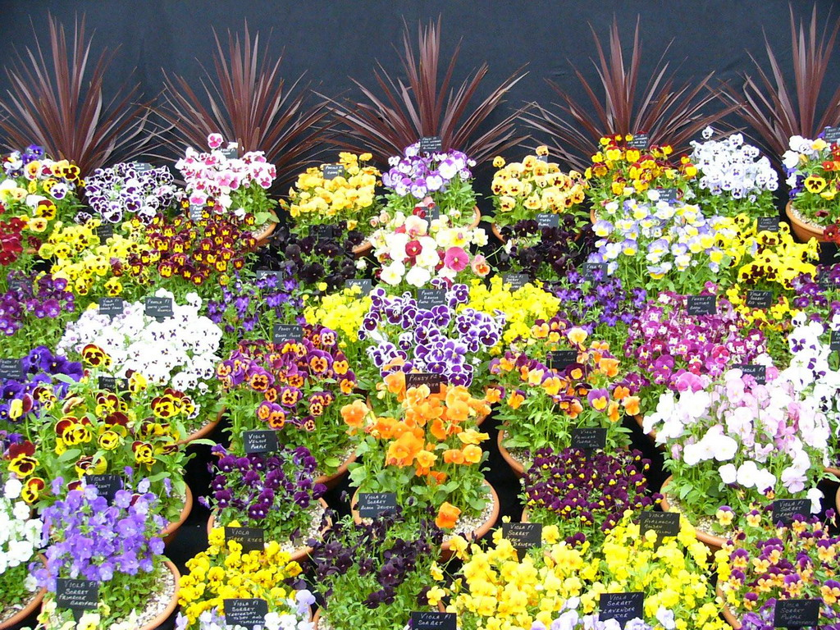
Notes:
Chelsea Flowers Show

Slide 14
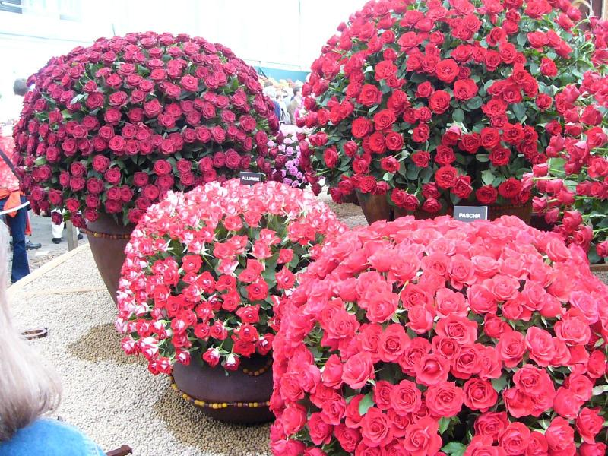
Notes:
Chelsea Flowers Show

Slide 15
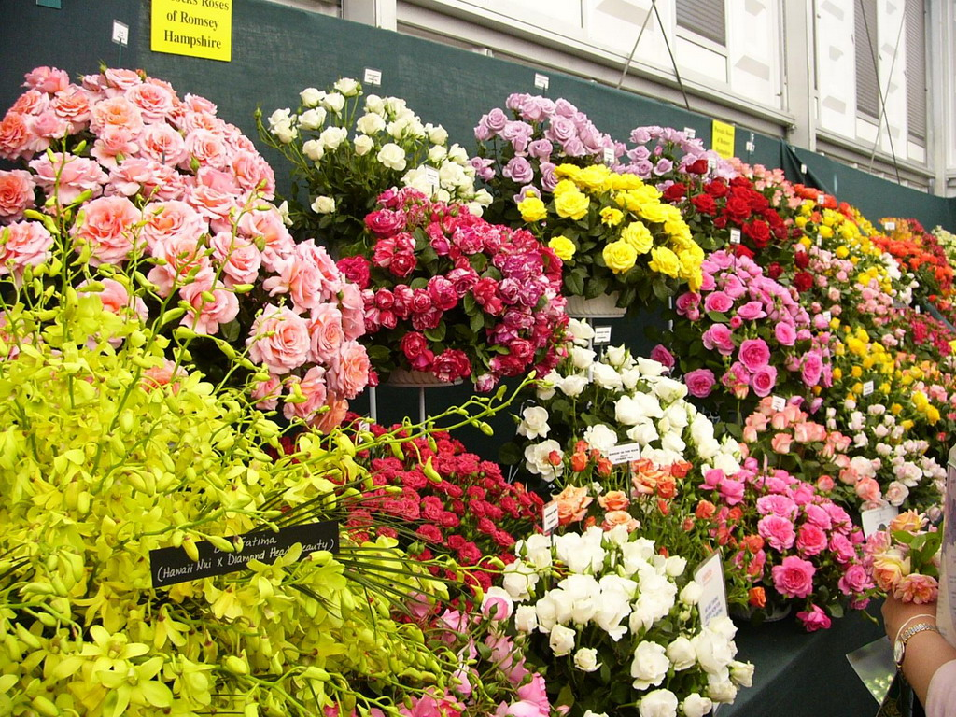
Notes:
Chelsea Flowers Show

Slide 16
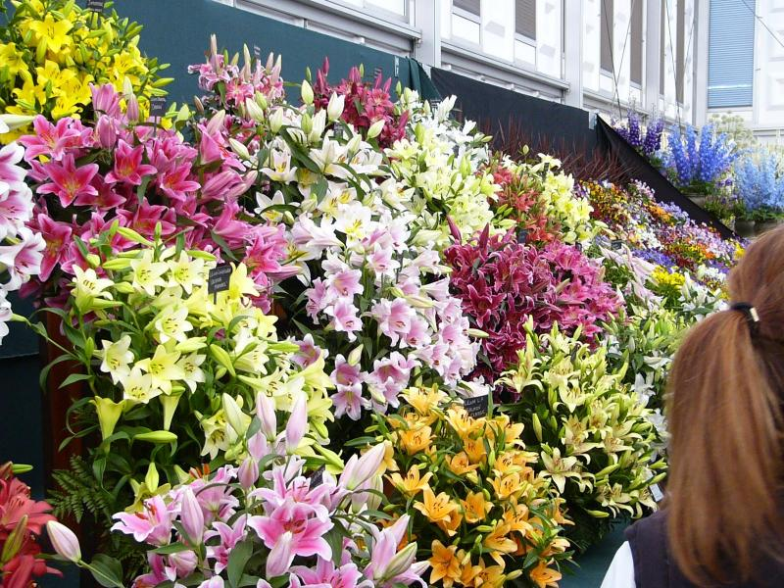
Notes:
Chelsea Flowers Show

Slide 17
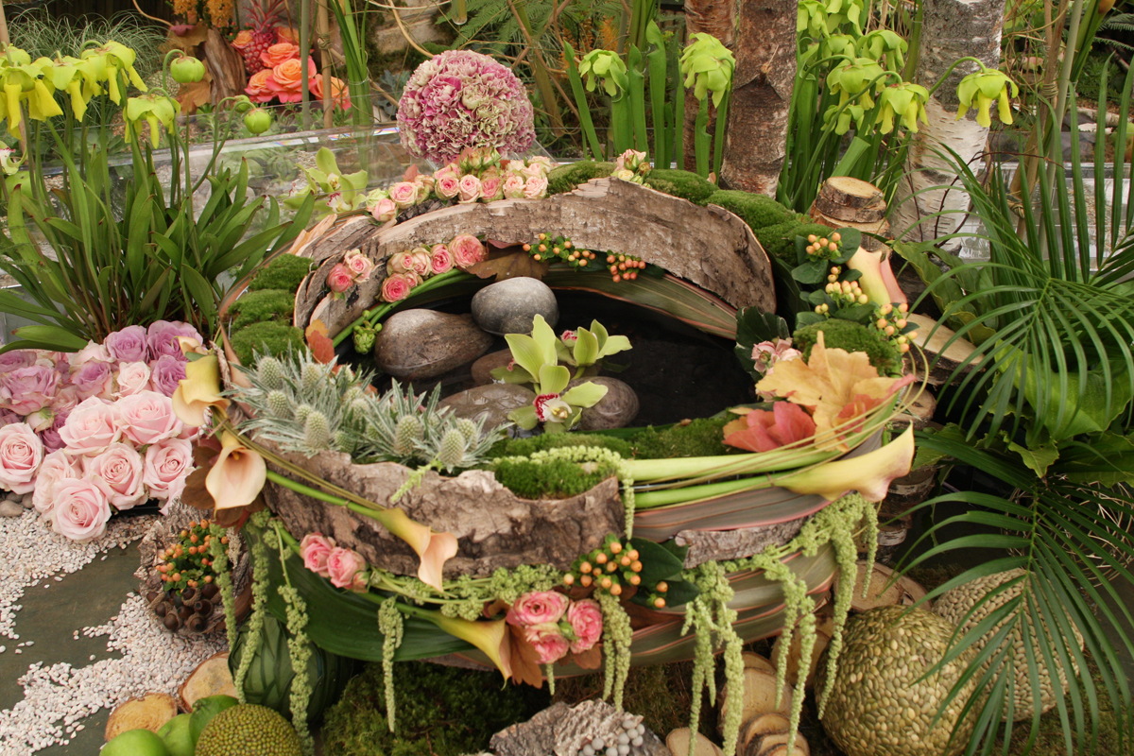
Notes:
Chelsea 2010

Slide 18
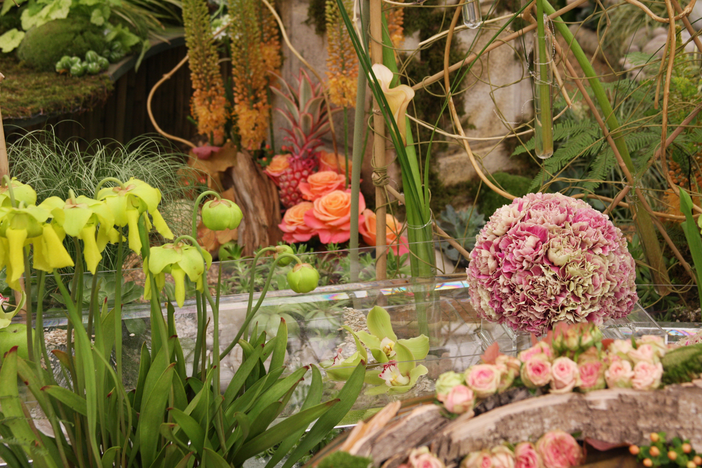
Notes:
Chelsea 2010

Slide 19
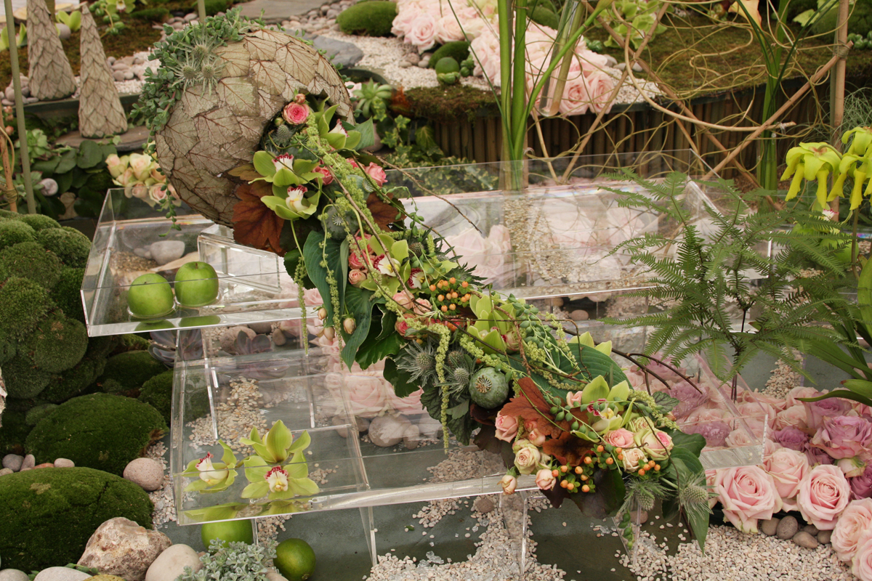
Notes:
Chelsea 2010

Slide 20
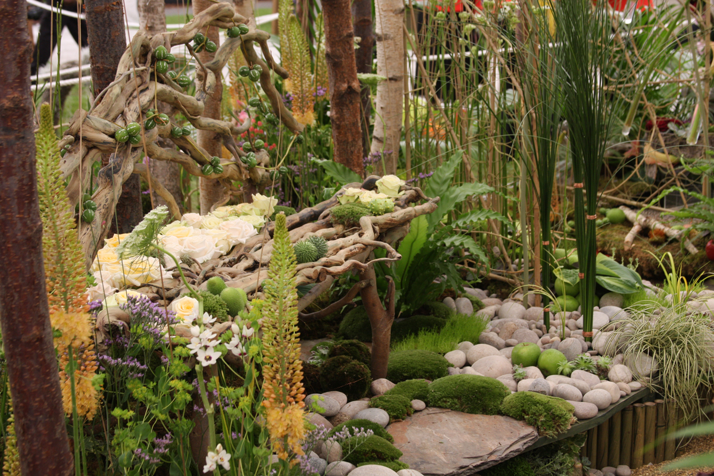
Notes:
Chelsea 2010

Slide 21
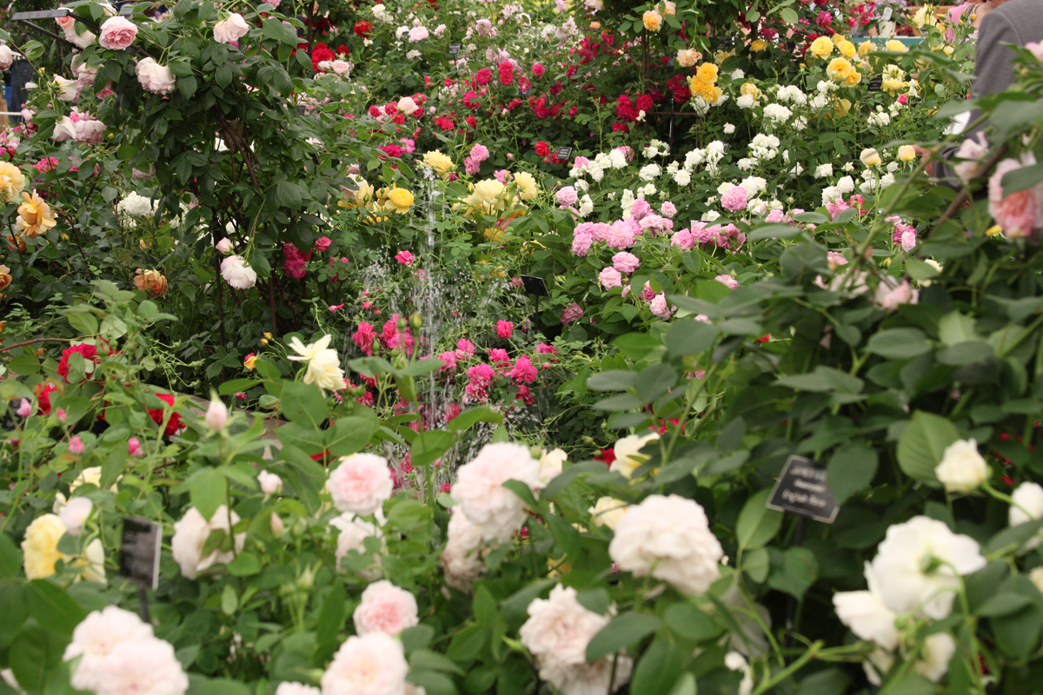
Notes:
Chelsea 2010

Slide 22
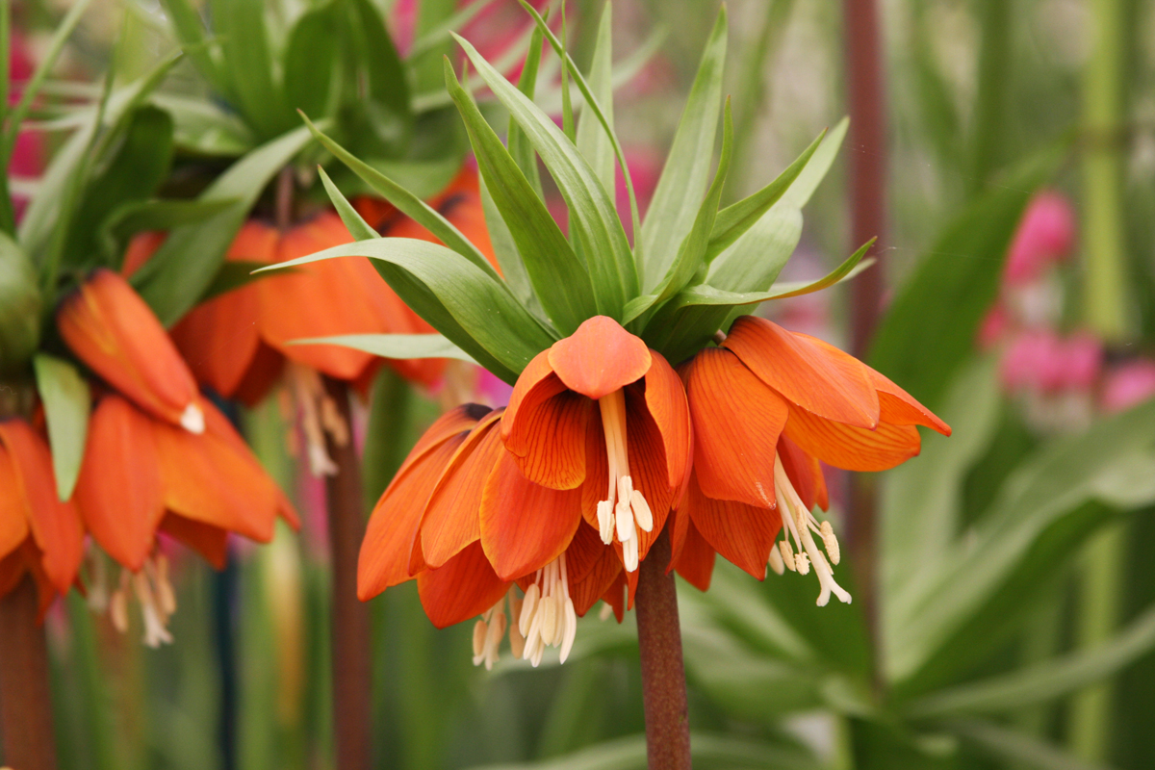
Notes:
Chelsea 2010

Slide 23
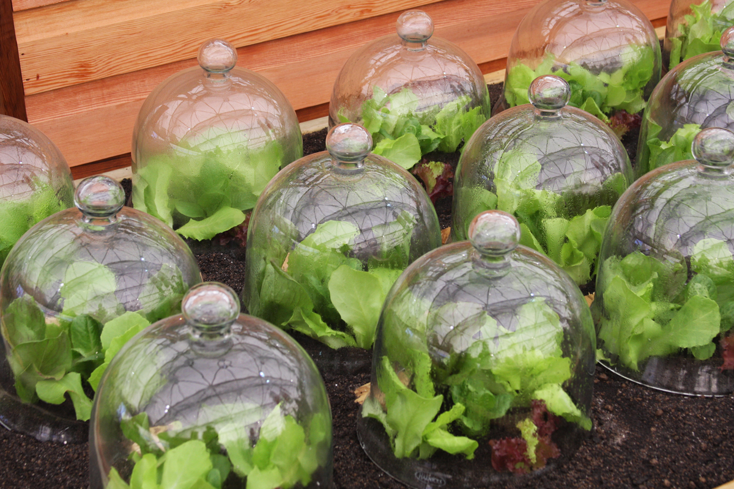
Notes:
Chelsea 2010

Slide 24
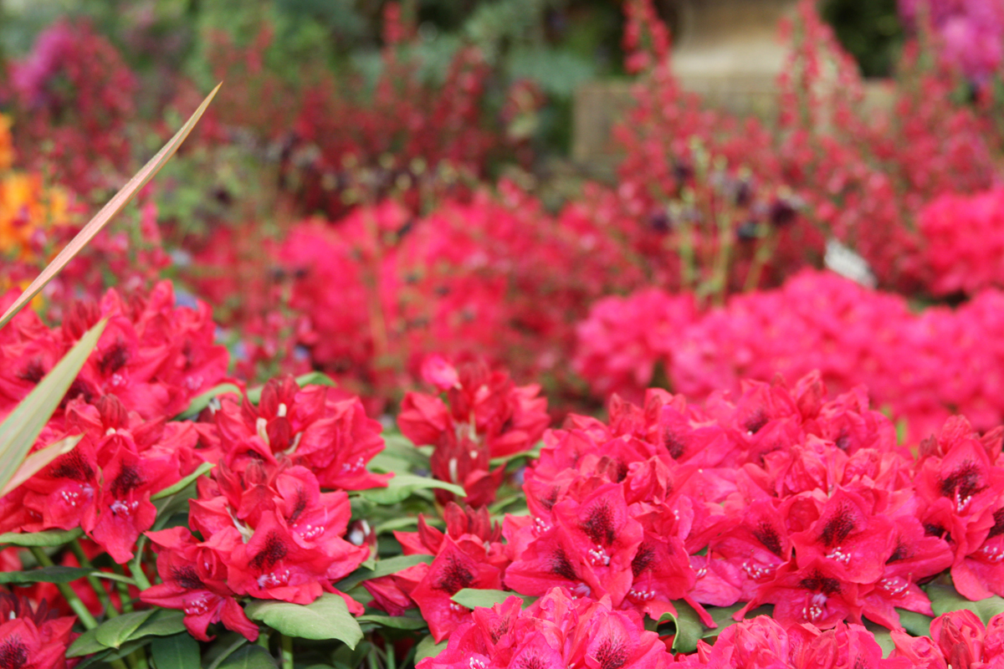
Notes:
Chelsea 2010

Slide 25
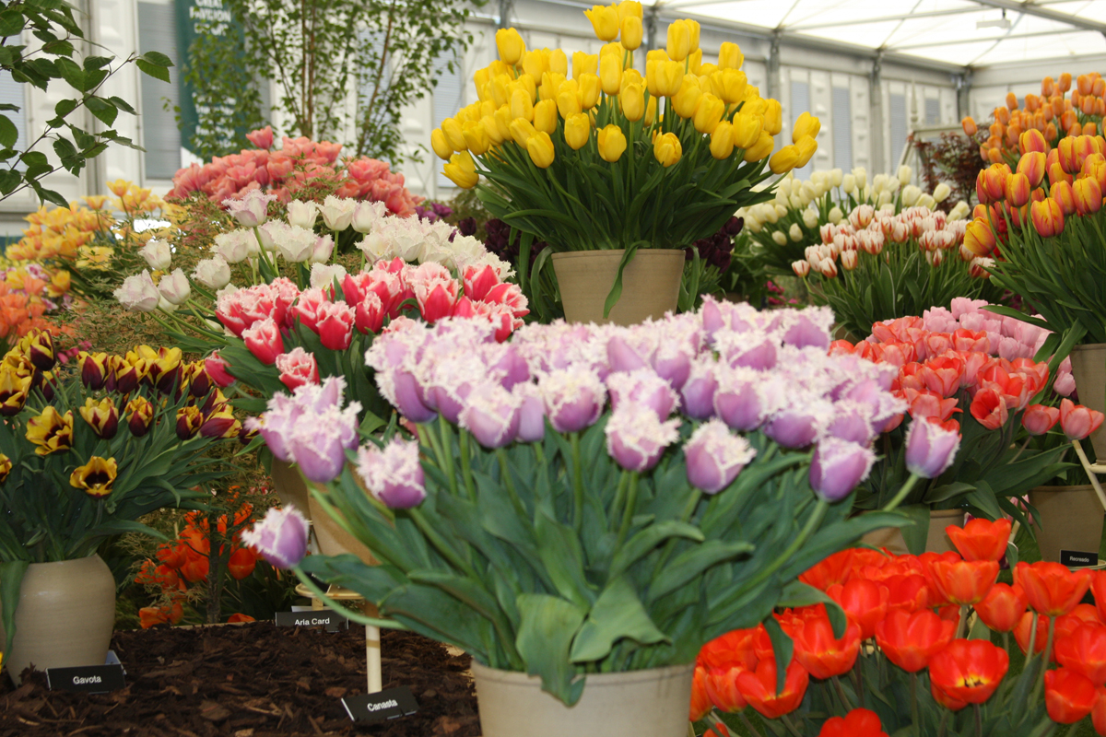
Notes:
Chelsea 2010

Slide 26
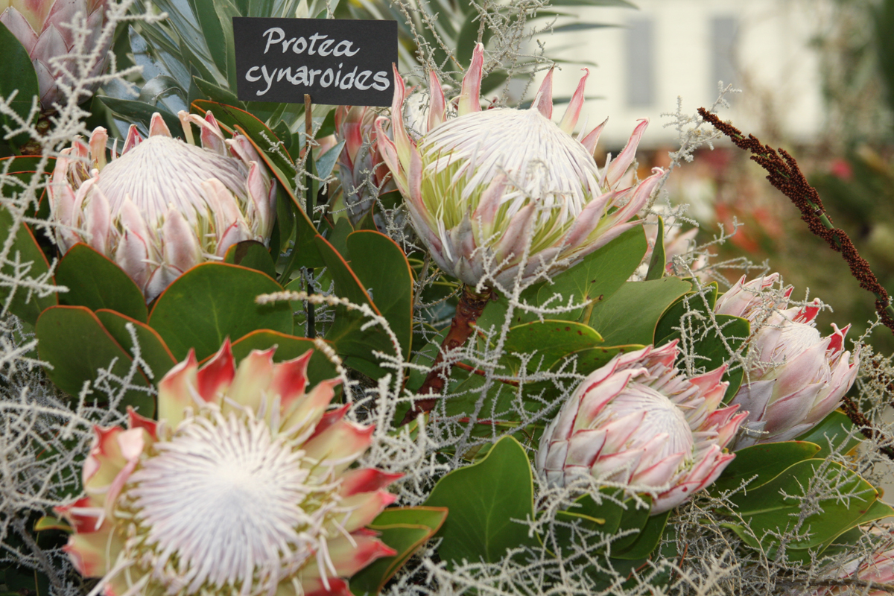
Notes:
Chelsea 2010

Slide 27
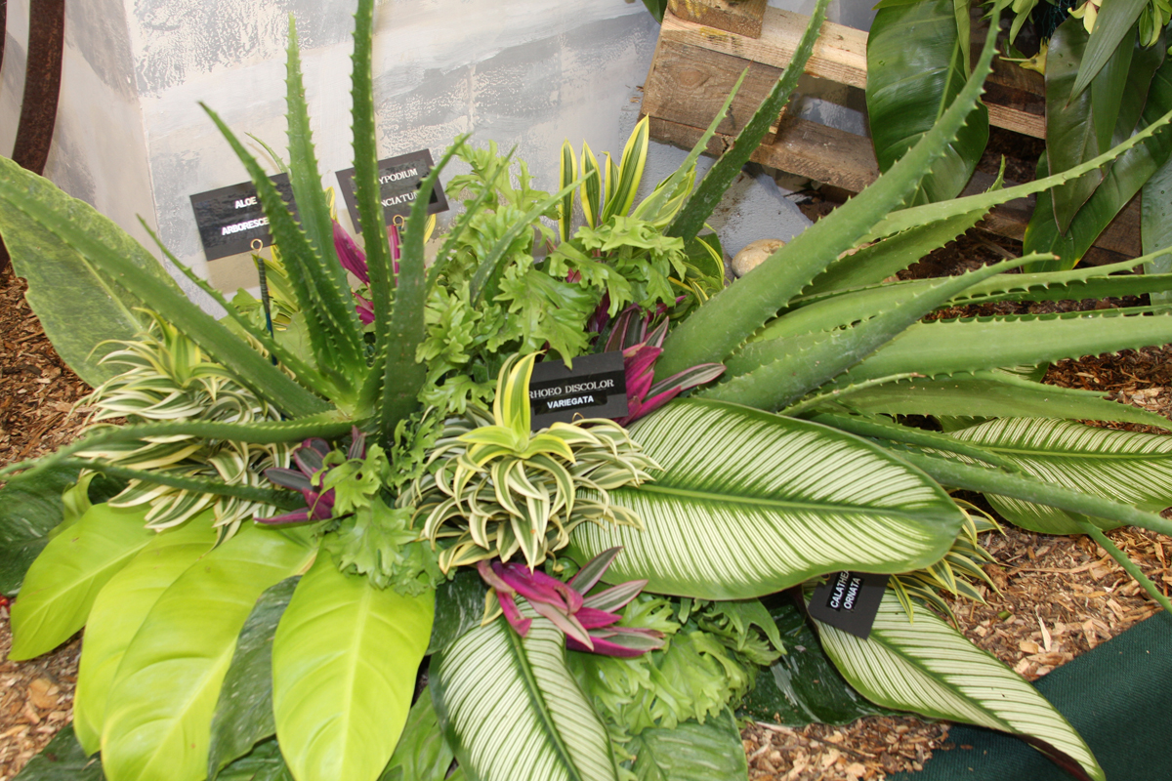
Notes:
Chelsea 2010

Slide 28
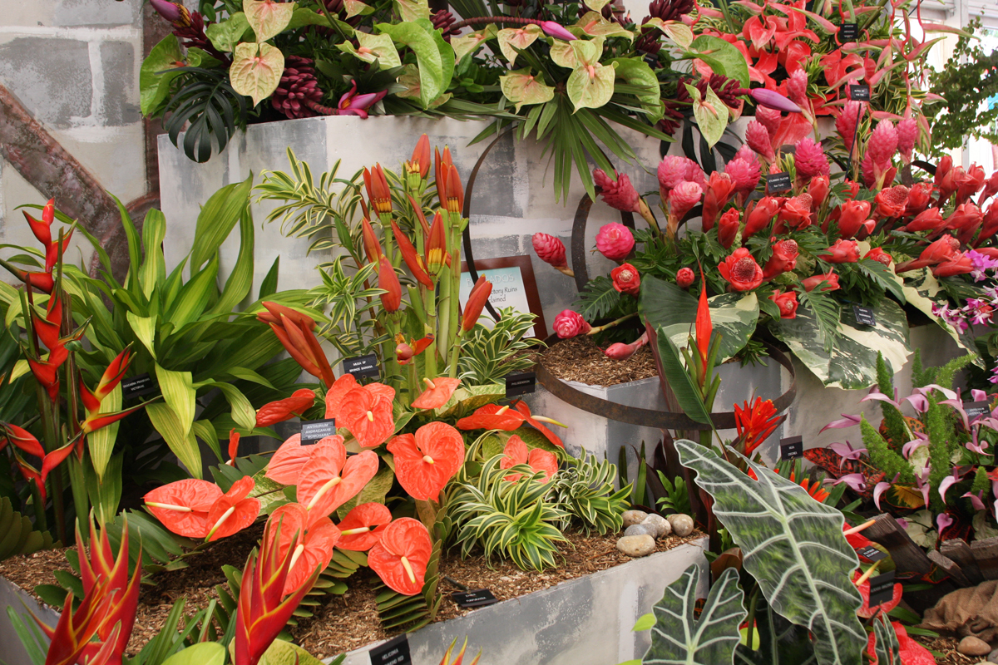
Notes:
Chelsea 2010

Slide 29
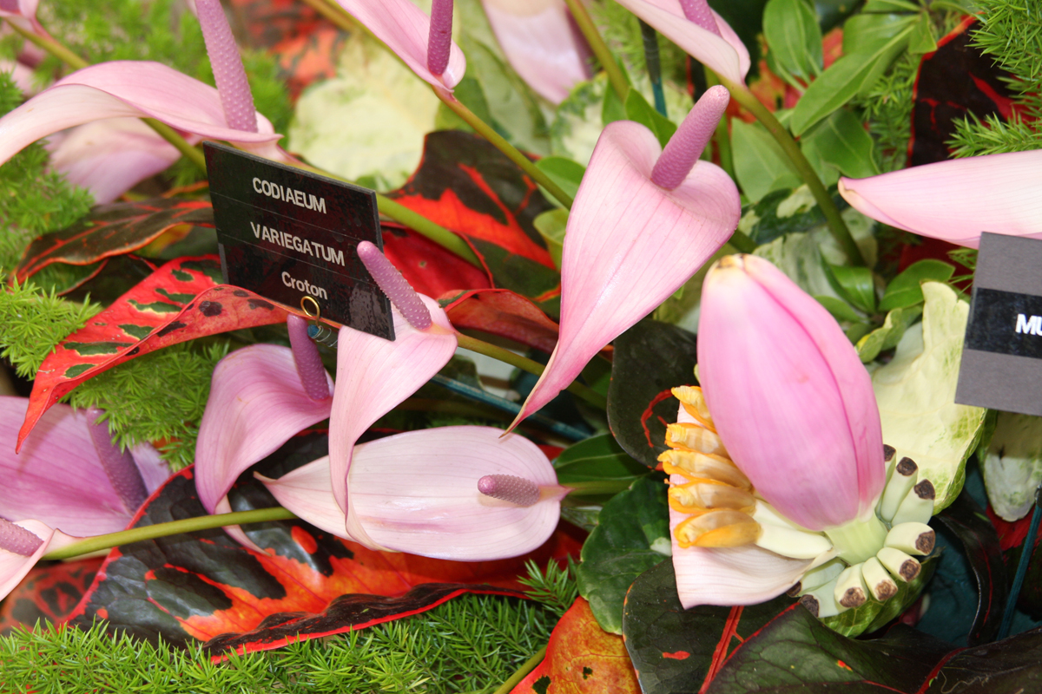
Notes:
Chelsea 2010

Slide 30
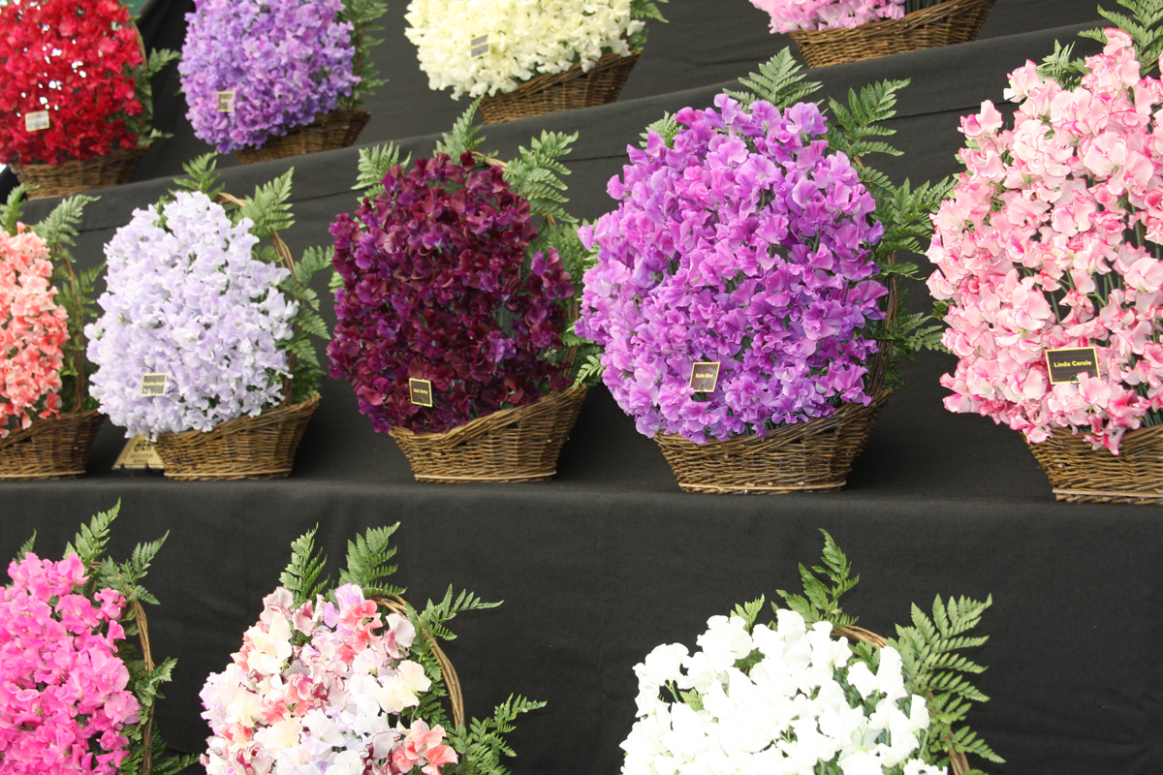
Notes:
Chelsea 2010

Slide 31
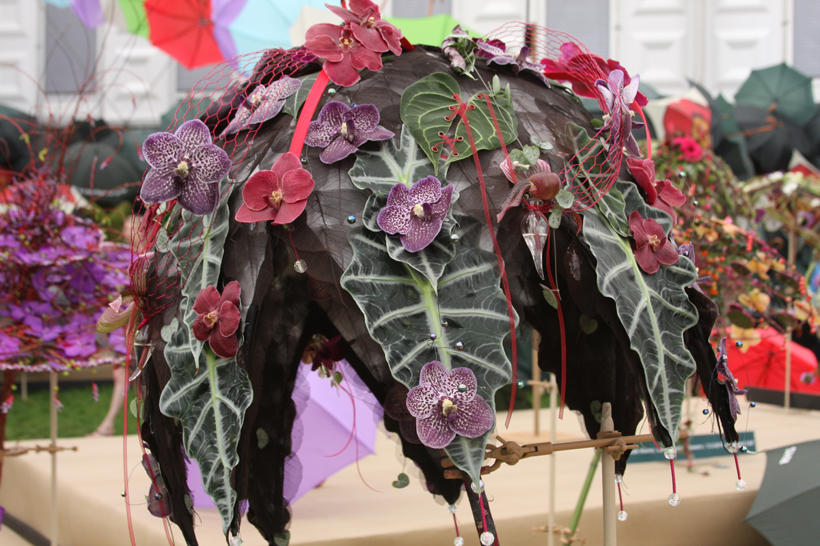
Notes:
Chelsea 2010

Slide 32
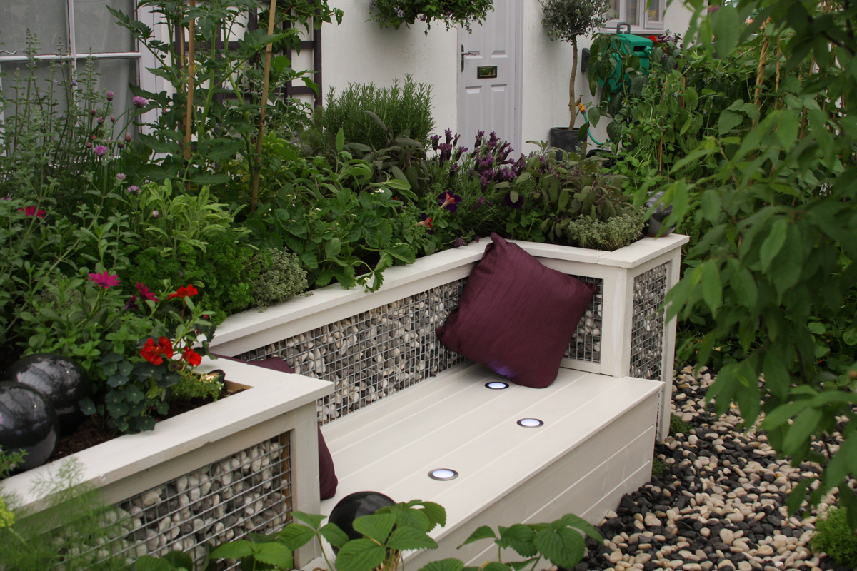
Notes:
Chelsea 2010

Slide 33
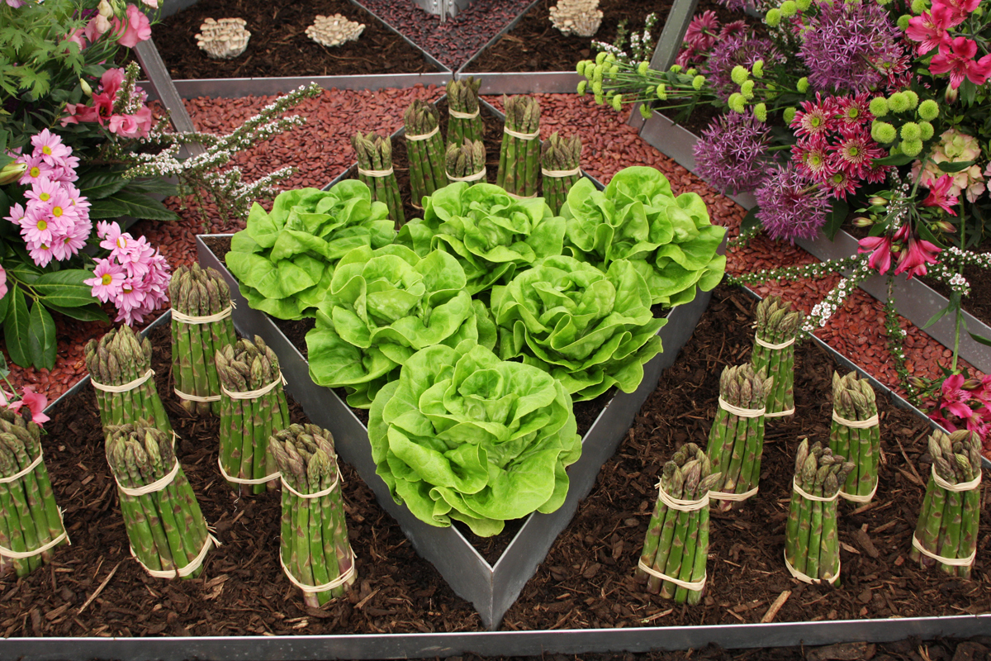
Notes:
Chelsea 2010

Slide 34
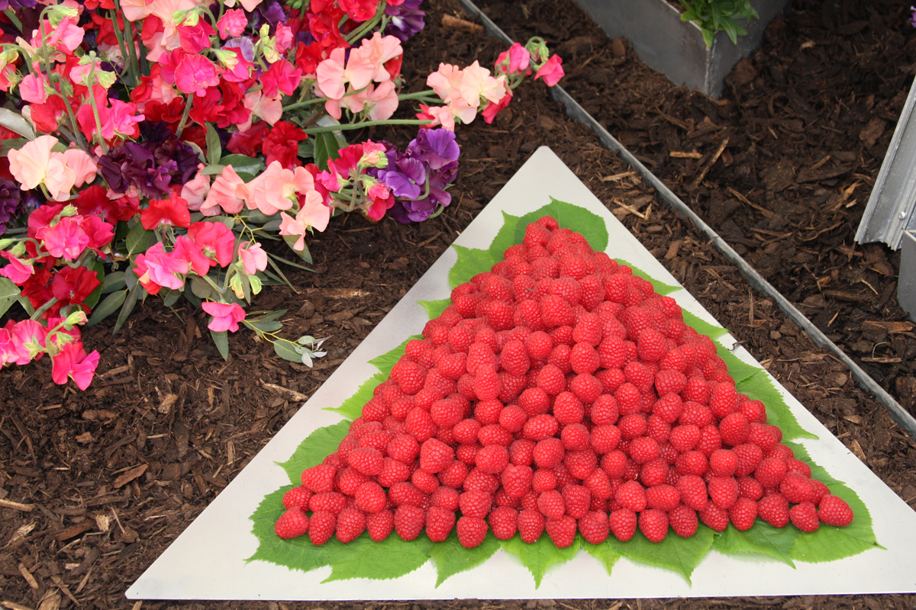
Notes:
Chelsea 2010

Slide 35
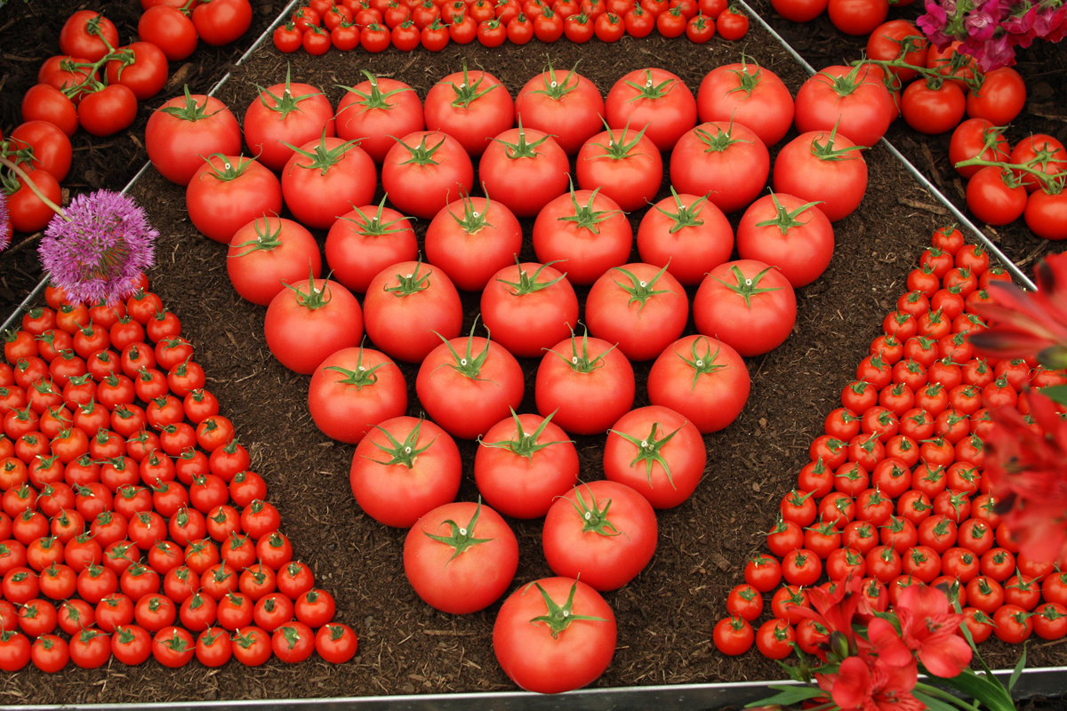
Notes:
Chelsea 2010

Slide 36
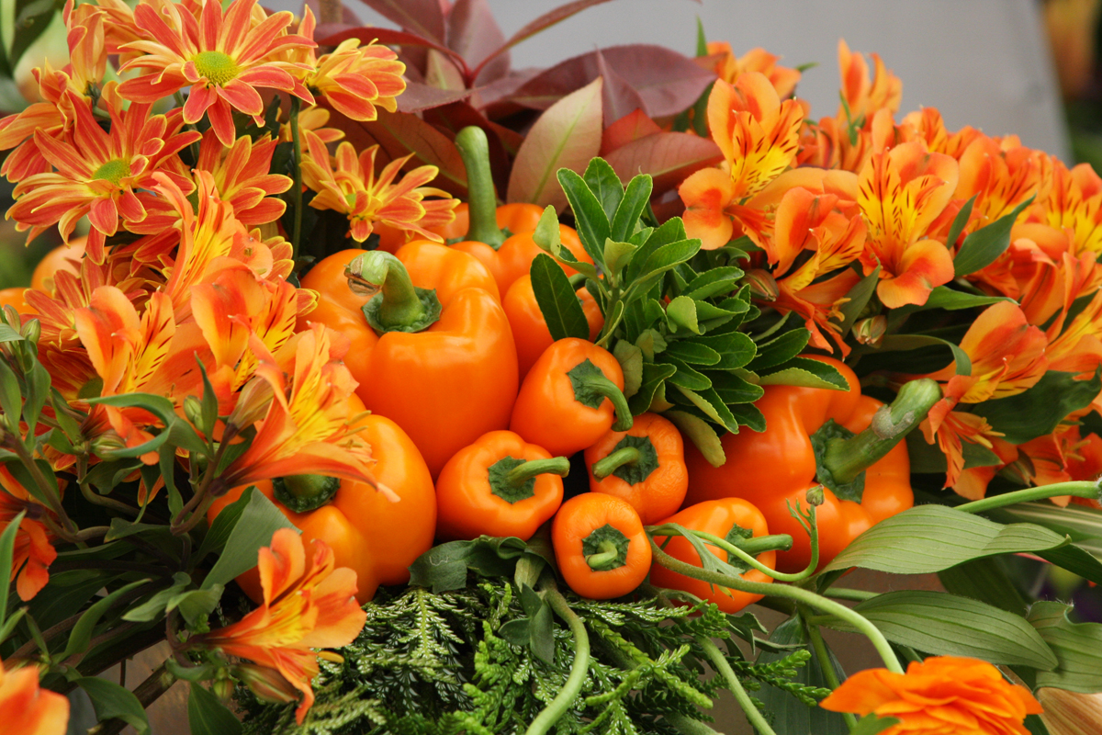
Notes:
Chelsea 2010

Slide 37
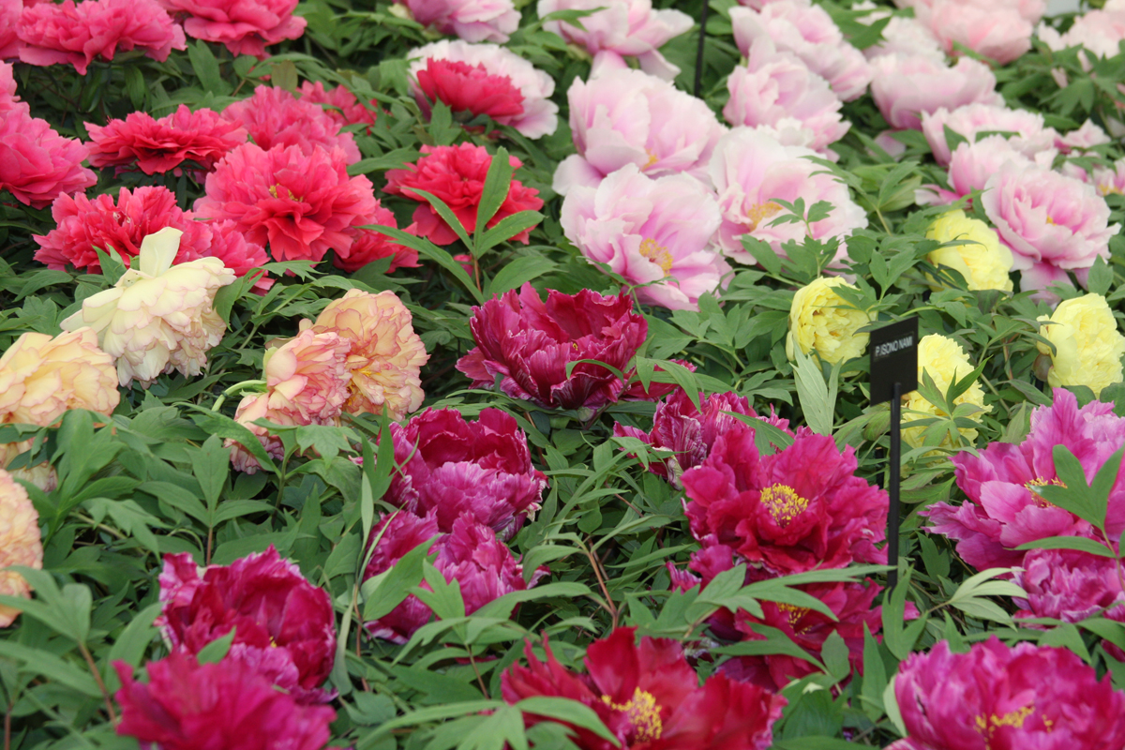
Notes:
Chelsea 2010

Slide 38
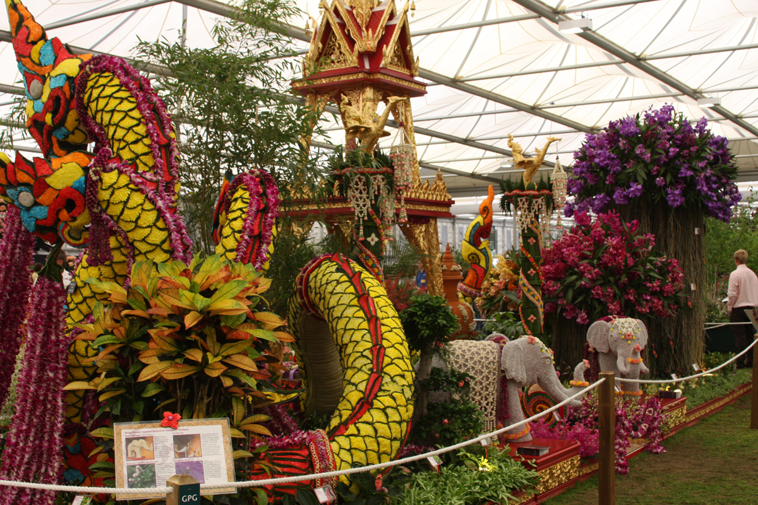
Notes:
Chelsea 2010

Slide 39
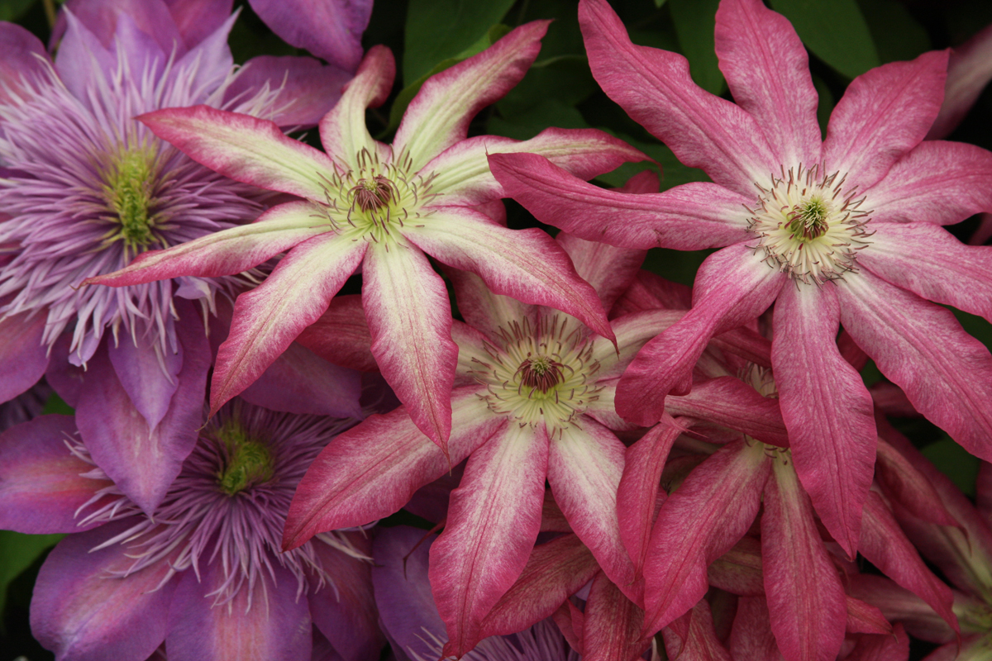
Notes:
Chelsea 2010.-Clematis

Slide 40
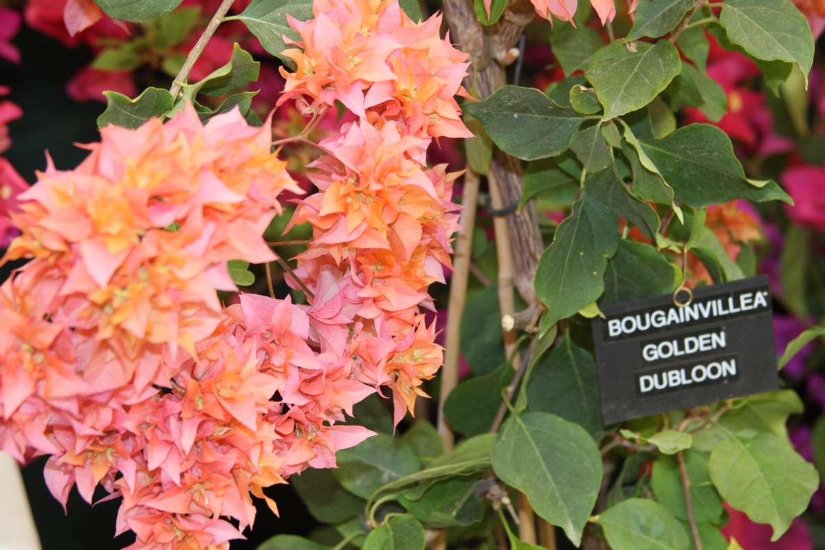
Notes:
Chelsea 2010

Slide 41
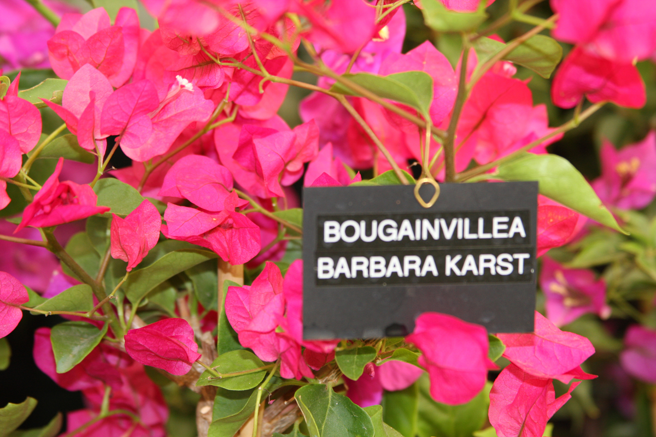
Notes:
Chelsea 2010

Slide 42
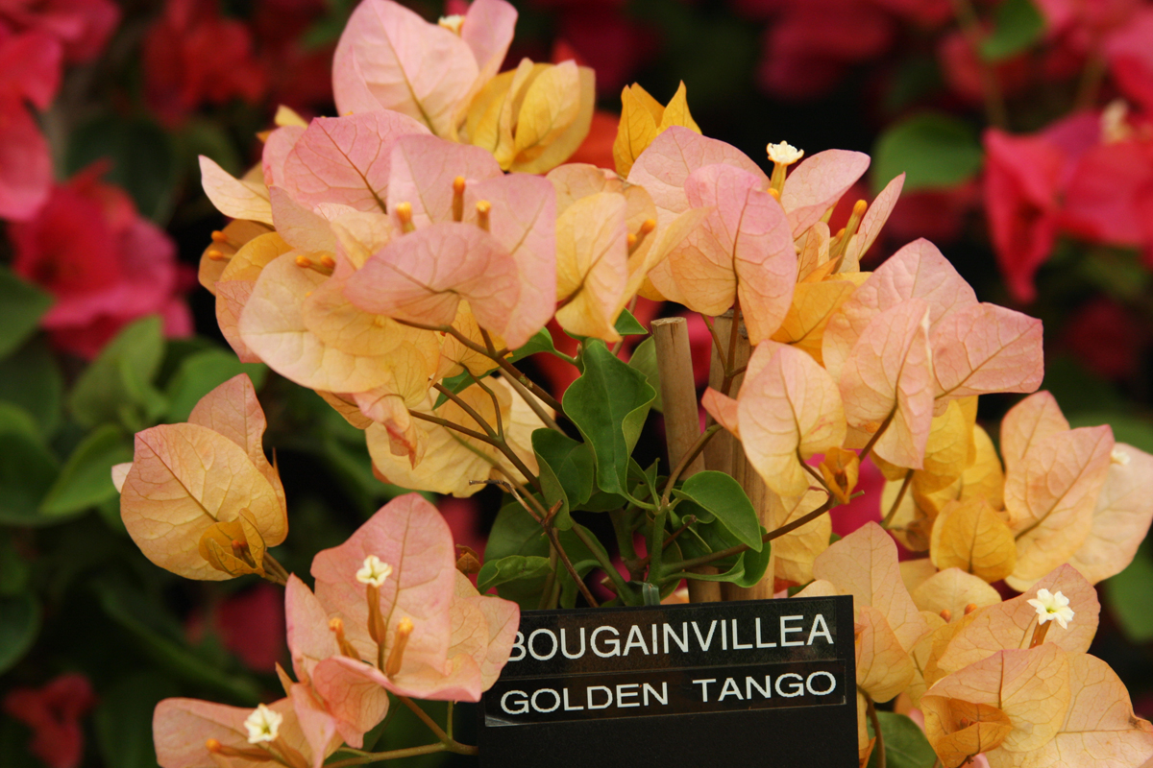
Notes:
Chelsea 2010

Slide 43
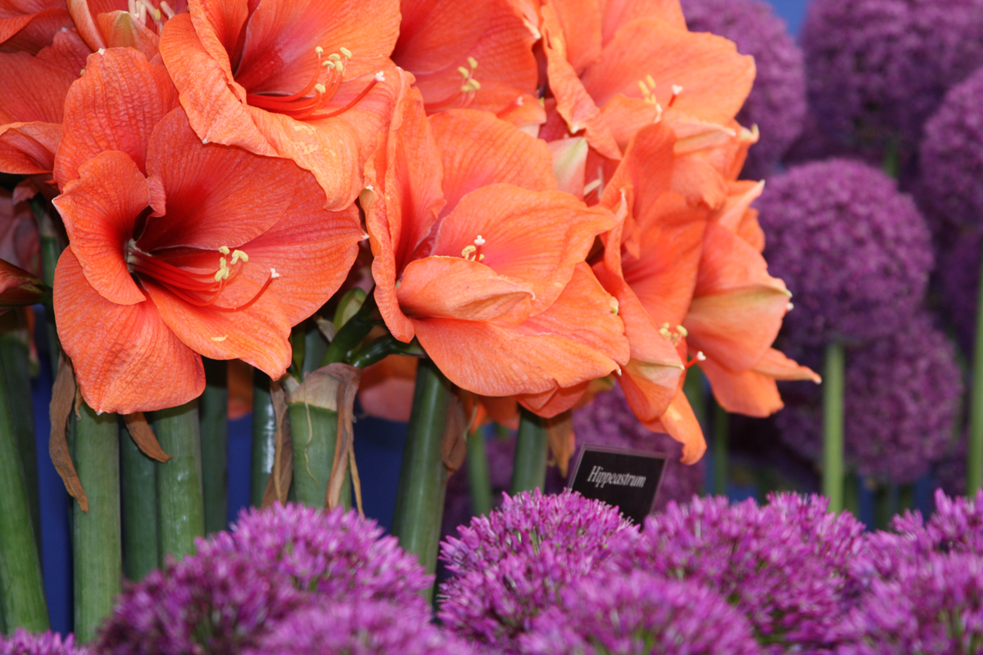
Notes:
Chelsea 2010

Slide 44
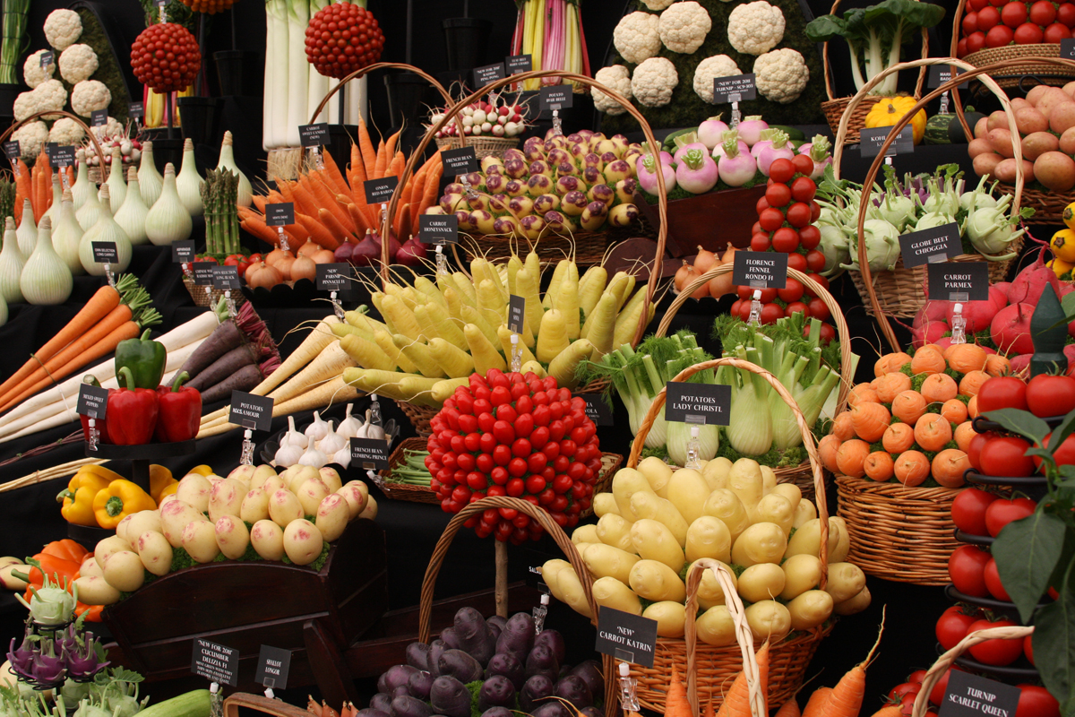
Notes:
Chelsea 2010

Slide 45
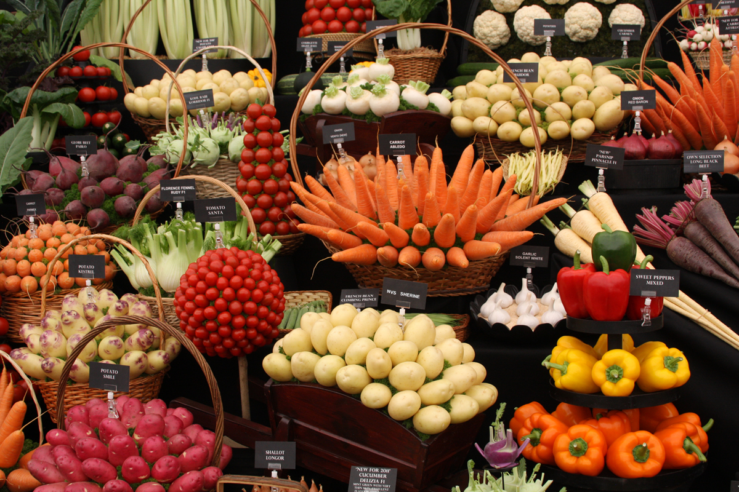
Notes:
Chelsea 2010

Slide 46
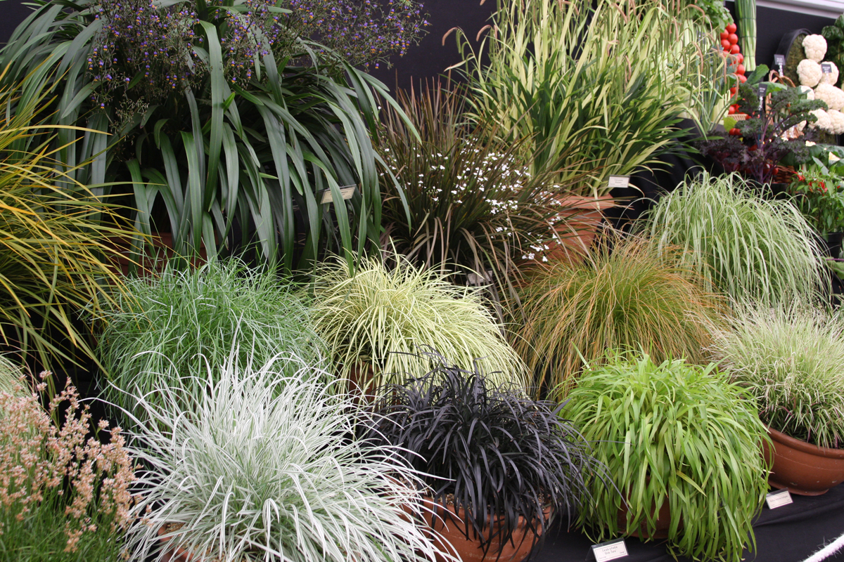
Notes:
Chelsea 2010

Slide 47
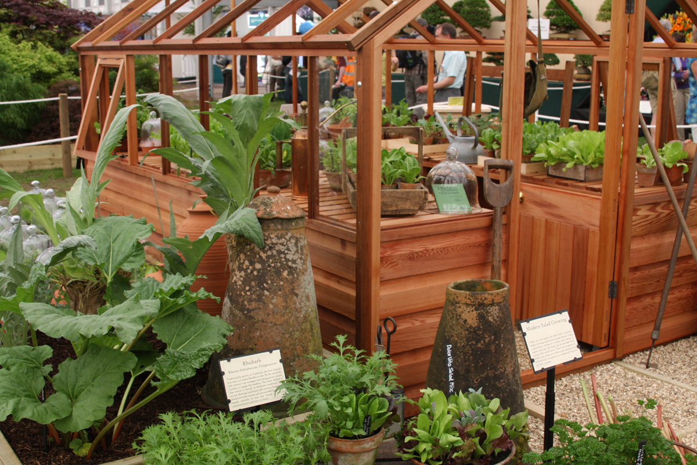
Notes:
Chelsea 2010

Slide 48
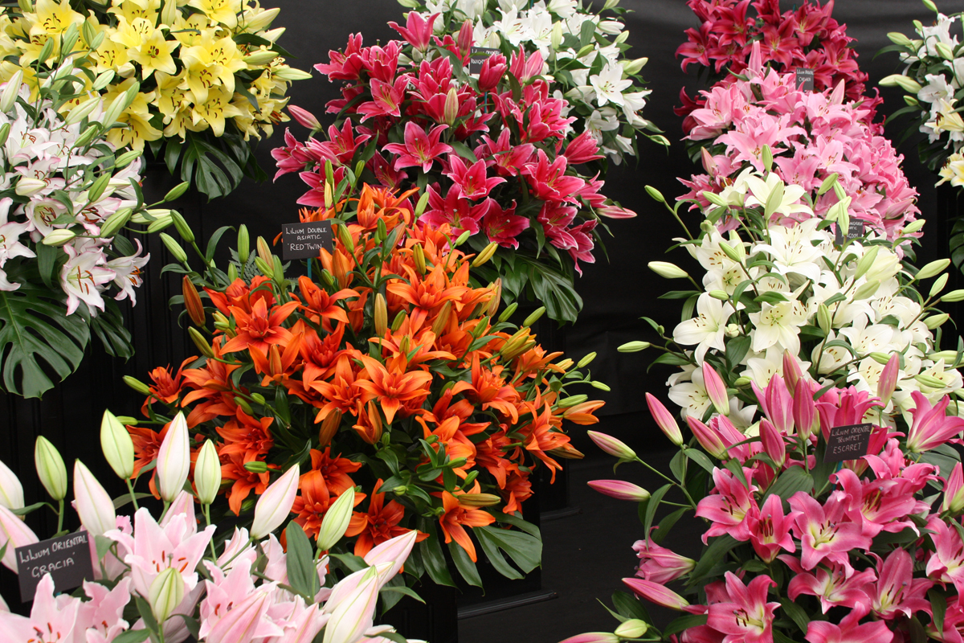
Notes:
Chelsea 2010

Slide 49
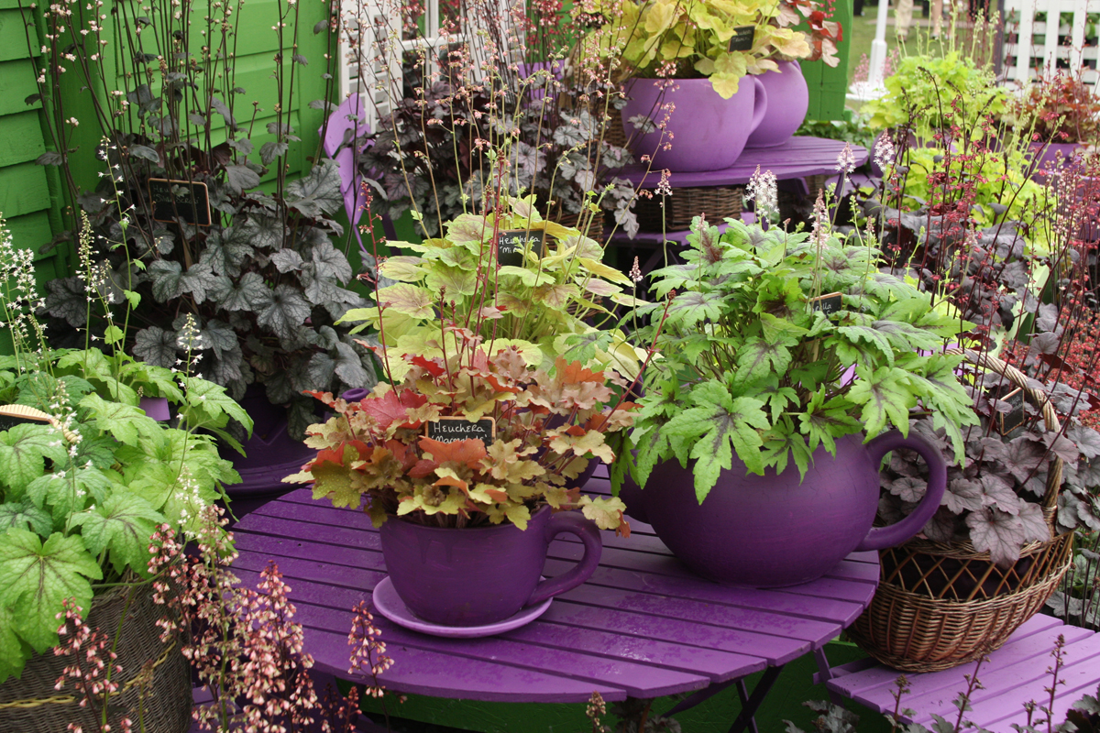
Notes:
Chelsea 2010

Slide 50
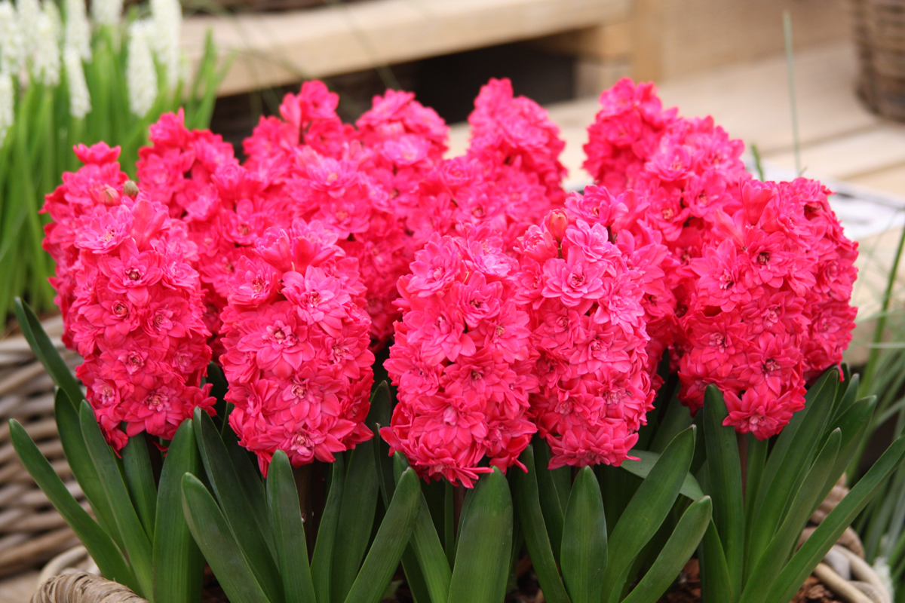
Notes:
Chelsea 2010

Slide 51
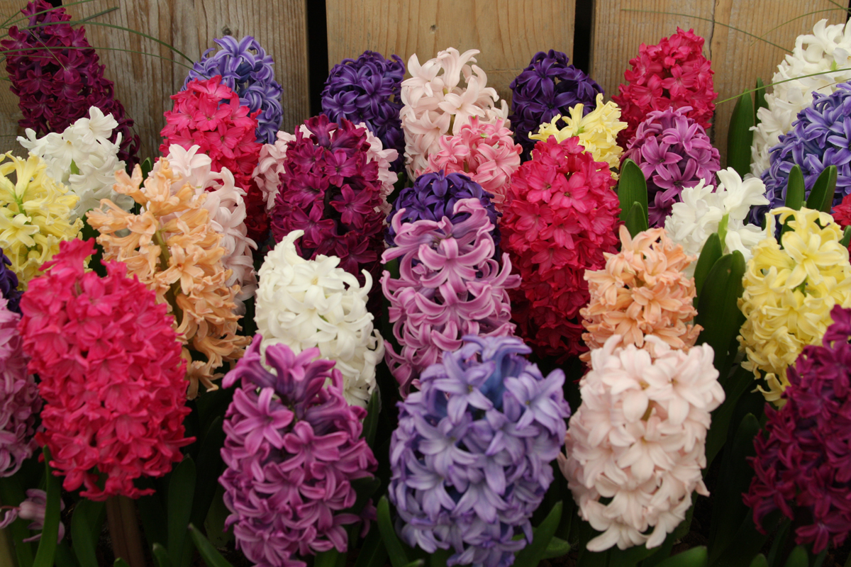
Notes:
Chelsea 2010

Slide 52

Notes:
Chelsea 2010

Slide 53

Notes:
Chelsea 2010

Slide 54

Notes:
Chelsea 2010

Slide 55

Notes:
Chelsea 2010

Slide 56

Notes:
Chelsea 2010

Slide 57

Notes:
Chelsea 2010

Slide 58

Notes:
Chelsea 2010

Slide 59

Notes:
Chelsea 2010

Slide 60

Notes:
Chelsea 2010

Slide 61

Notes:
Chelsea 2010

Slide 62

Notes:
Chelsea 2010

Slide 63

Notes:
Chelsea 2010

Slide 64

Notes:
Chelsea 2010

Slide 65

Notes:
Chelsea 2010

Slide 66

Notes:
Chelsea 2010

Slide 67

Notes:
Chelsea 2010

Slide 68

Notes:
Chelsea 2010

Slide 69

Notes:
Chelsea 2010

Slide 70

Notes:
Chelsea 2010

Slide 71

Notes:
Chelsea 2010

Slide 72

Notes:
Chelsea 2010

Slide 73

Notes:
Chelsea 2010

Slide 74

Notes:
Chelsea 2010

Slide 75

Notes:
Chelsea 2010

Slide 76

Notes:
Chelsea 2010

Slide 77

Notes:
Chelsea 2010

Slide 78

Notes:
Chelsea 2010

Slide 79

Notes:
Chelsea 2010

Slide 80

Notes:
Chelsea 2010

Slide 81

Notes:
Chelsea 2010

Slide 82

Notes:
Chelsea 2010

Slide 83

Notes:
Chelsea 2010

Slide 84

Notes:
Chelsea 2010

Slide 85

Notes:
Chelsea 2010

Slide 86

Notes:
Chelsea 2010

Slide 87
Chelsea Flowers Show.-2013

Slide 88

Notes:
Chelsea Flower Show

Slide 89

Notes:
Chelsea.-Sanctuary

Slide 90

Notes:
Chelsea.-Best in Show

Slide 91

Notes:
Chelsea Flower Show.-Indoor Garden

Slide 92

Notes:
Chelsea Show Garden

Slide 93

Notes:
Chelsea Flowers Show.-Herb Garden

Slide 94

Notes:
Chelsea Flowers Show

Slide 95

Notes:
Chelsea Flowers Show

Slide 96

Notes:
Chelsea Flowers Show

Slide 97

Notes:
Chelsea Flowers Show

Slide 98

Notes:
Chelsea Flowers Show.-Trasparency

Slide 99

Notes:
Chelsea Flowers Show.-Sculptures

Slide 100

Notes:
Chelsea Flowers Show

